Slide 1
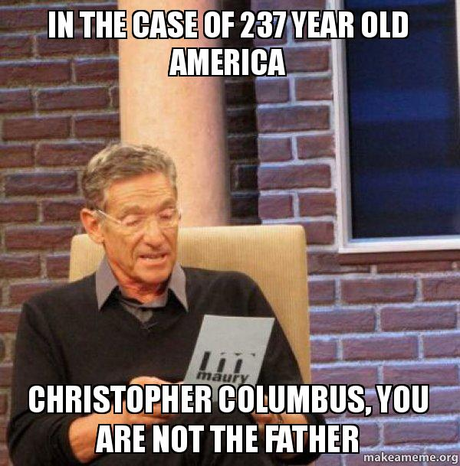
Exploration and Conquest

Slide 2
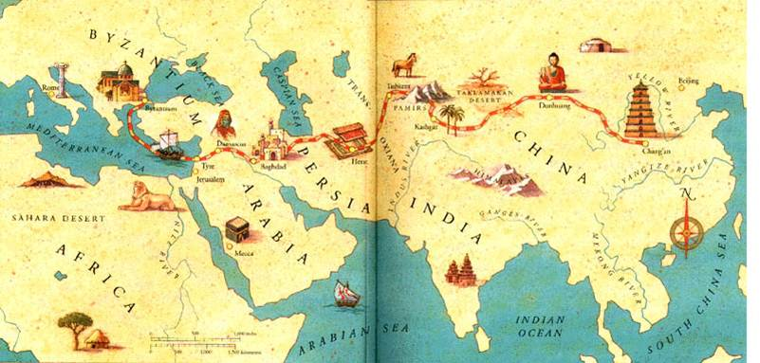
I. European Exploration
Why Explore?
Wealth from direct trade with Asia
Spread the faith

Slide 3
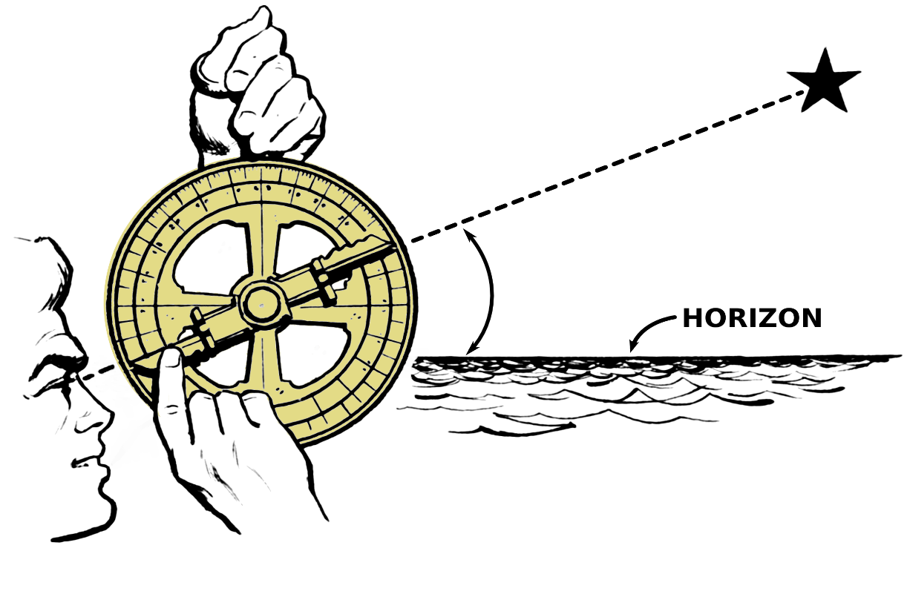
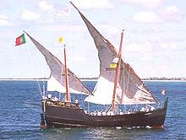
3. Spirit of Renaissance exploration and discovery
4. New technologies
Caravel- long distance ship with triangular sails
Compass -navigational tool
Astrolabe- using the stars to find position

Slide 4
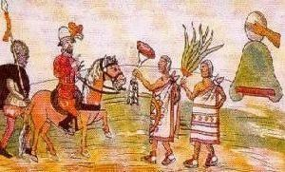
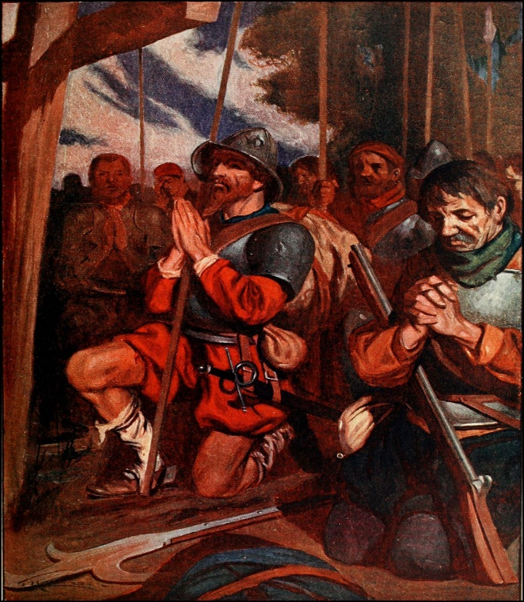
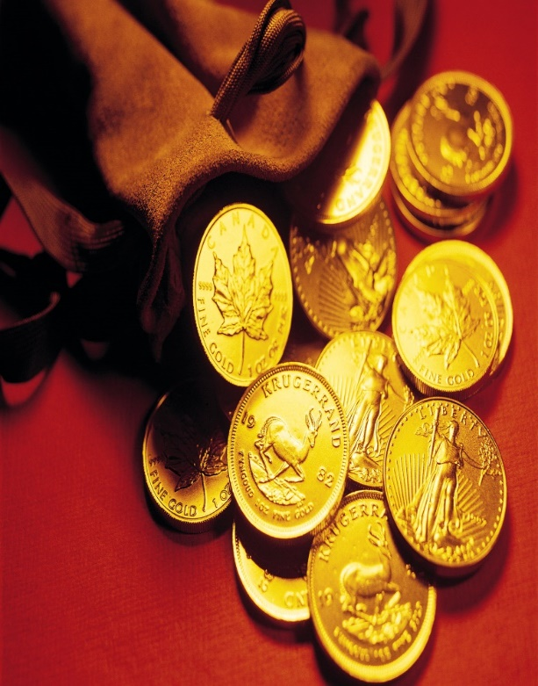
II. Conquistadors
A. Conquistadors- Spanish conquerors of Americas
B. Why conquer the Americas?
1. god, glory, gold
C. Able to conquer because of their newness, modern weapons (horses, steel, and gunpowder), and diseases

