Slide 1
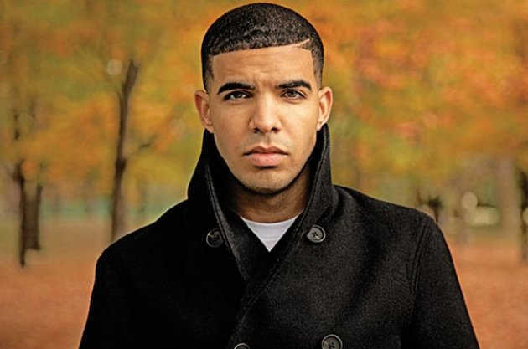
“Four Early Civilizations” Continued
Started from Mesopotamia now we’re here.

Slide 2
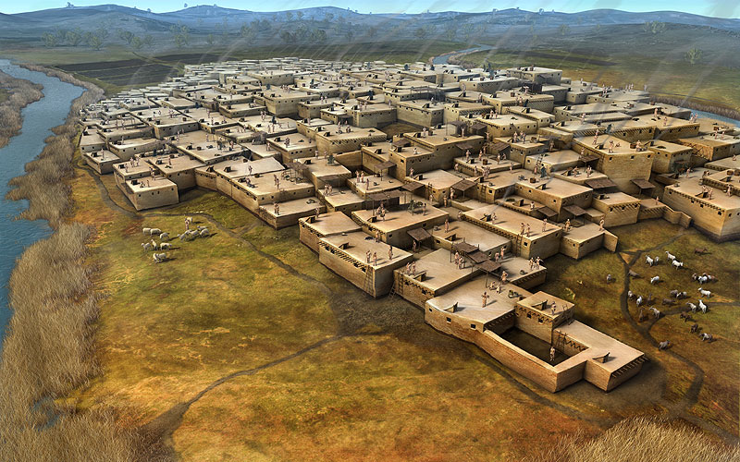
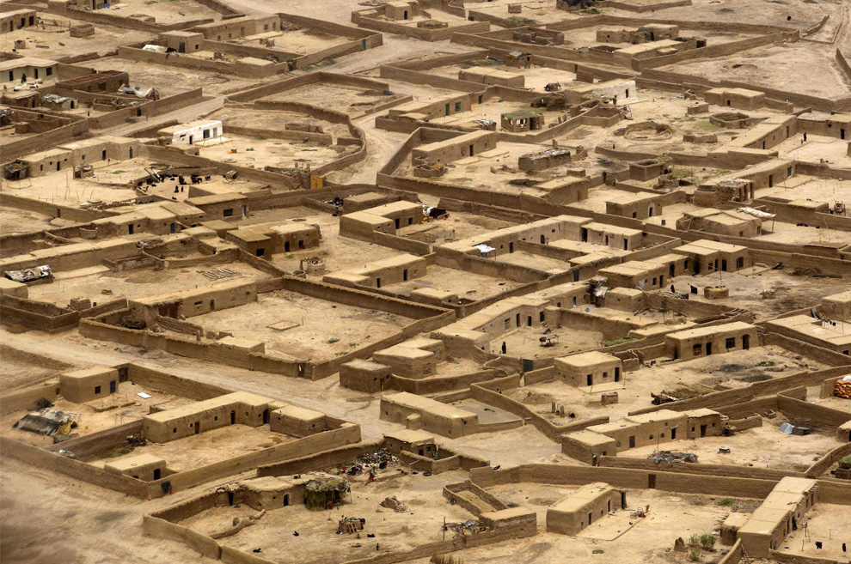
II. Organization
Cities
Larger than villages with diverse populations and formal organization
Centers of trade
City-state- a political unit based on a city government and the land around that it controlled

Slide 3
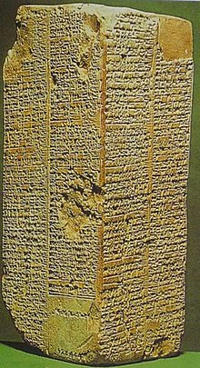
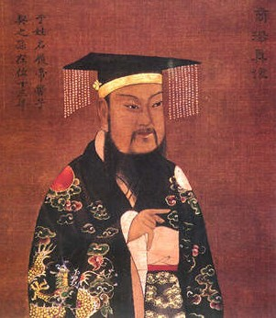
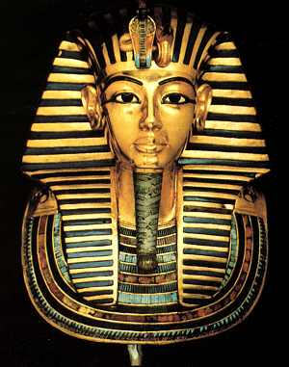
B. Government
1. Ruled by kings who formed dynasties- rulers come from one family

Slide 4
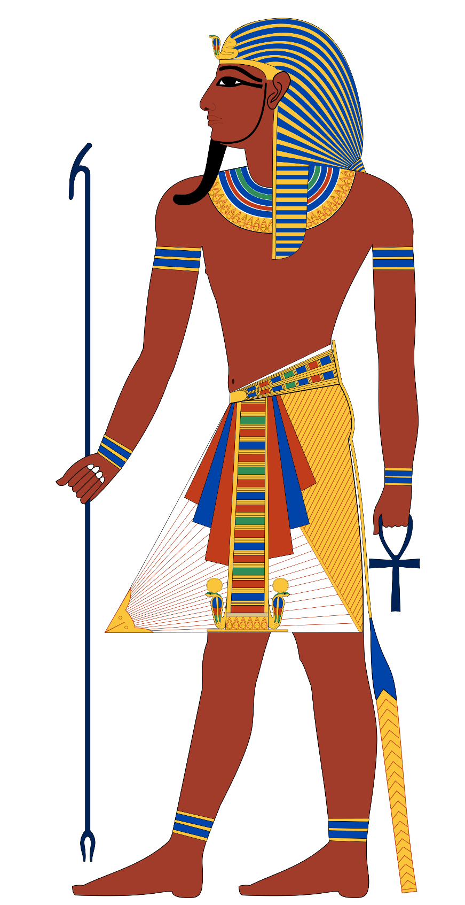
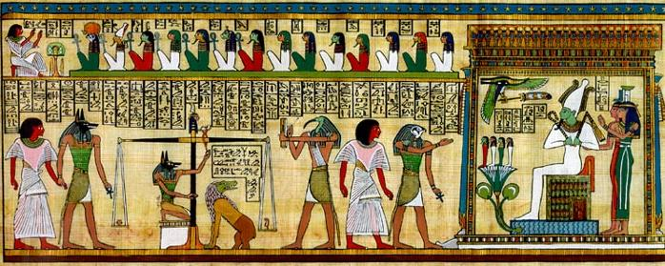
2. Usually close connection between religion and government:
a. theocracy- rule based on religious authority
b. Egypt was ruled by pharaohs- kings who were believed to be descended from the gods

Slide 5
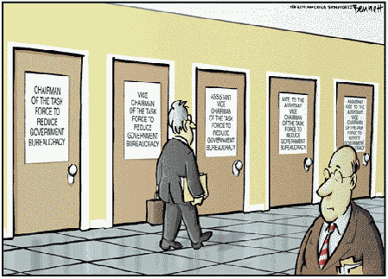
3. Complex governments developed bureaucracies - structured, organized government run by non-elected, policy-making, trained officials

Slide 6
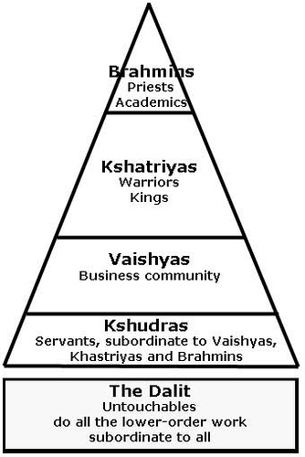
III. Society
Social Classes
Kings and priests
Large landowners and wealthy merchants
Artisans (skilled craftspeople), farmers, laborers
Slaves

Slide 7
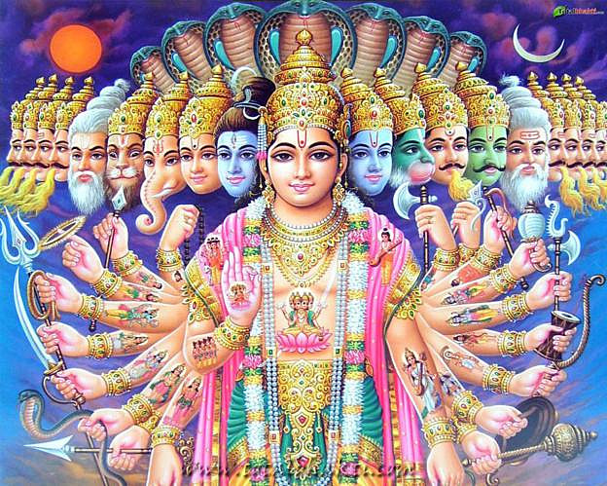
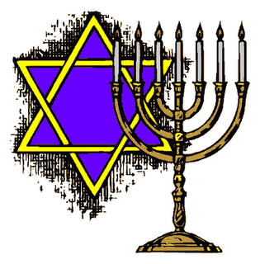
B. Religion and Philosophy
1. Most early religions were polytheistic- worship of many gods
2. First formalized religion was Hinduism (India)
3. Hebrews (in Mesopotamia) developed monotheistic religion- Judaism

Slide 8
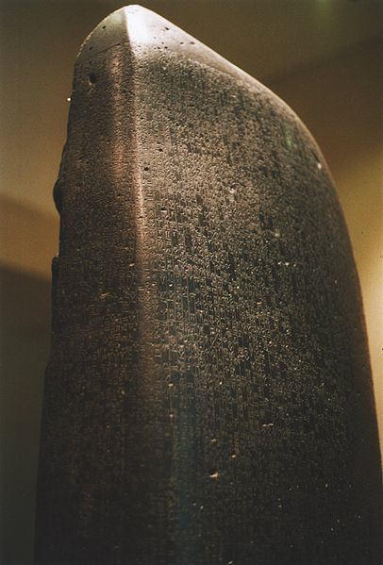
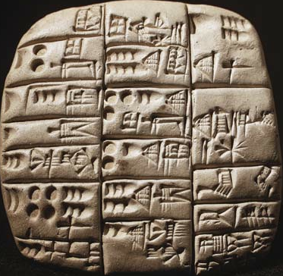
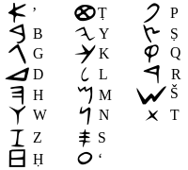
IV. Expression
A. Writing
1. Earliest writing systems were cuneiform (Sumer) and hieroglyphics (Egypt)
2. Hammurabi’s Code- first written legal code (Babylon)
3. Phoenicians- developed the first alphabet

Slide 9
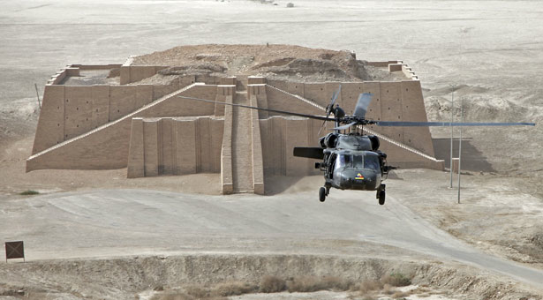
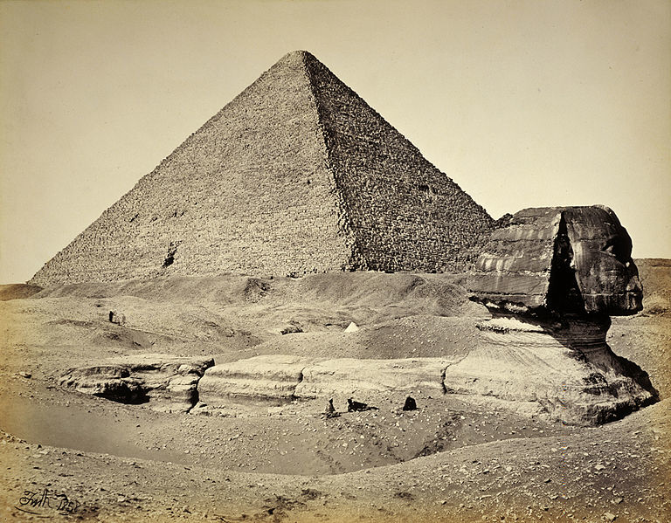
B. Art and Architecture
1. At the heart of each Sumerian city was a ziggurat- a pyramid-shaped temple
2. Egyptians built pyramids- tombs for pharaohs

