Slide 1
Islamic Gunpowder Empires: Safavid and Mughal

Slide 2
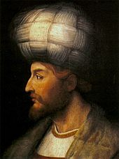
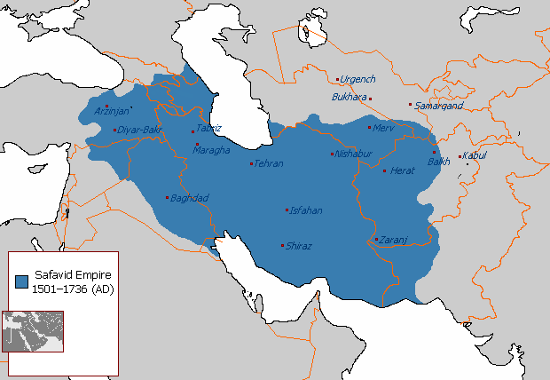
II. Safavid Empire (1500-1722)
A. Located: Persia (modern day Iran), Shi’a Muslim
B. Persecuted the Sunni, came into conflict with the Ottomans and other Muslims

Slide 3
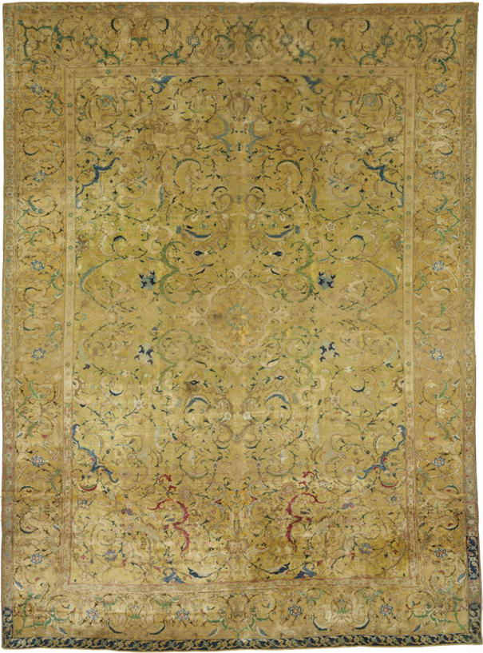
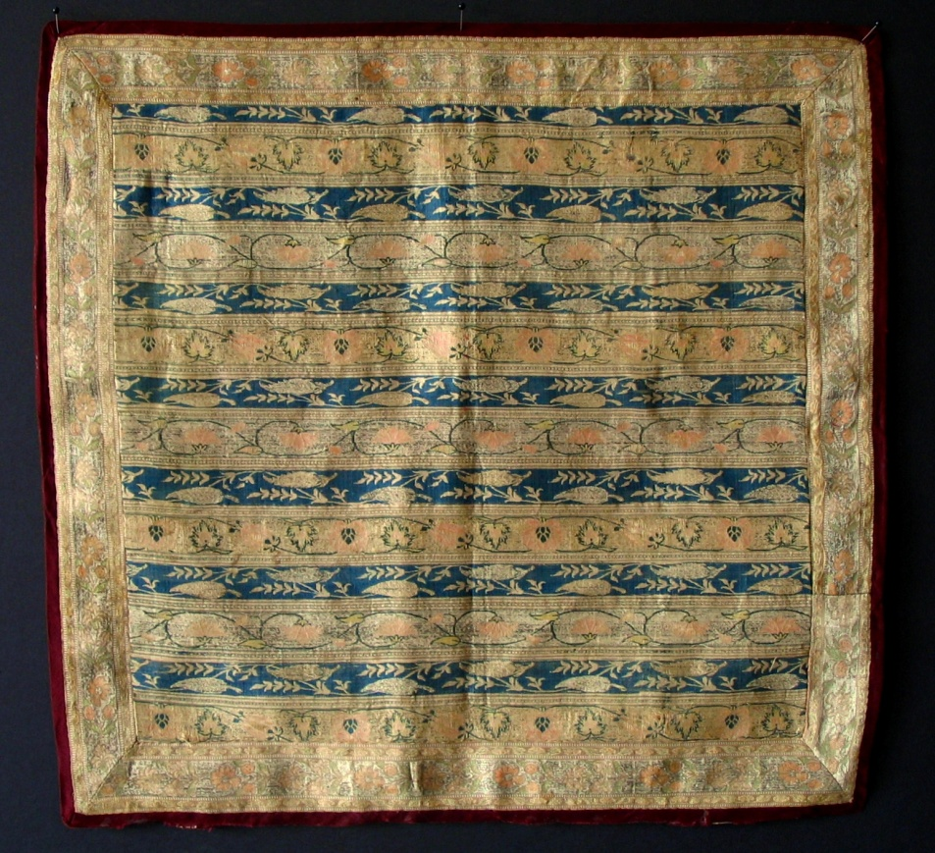
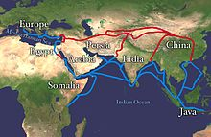
C. Traded silk, carpets, and ceramics along the Silk Road to the West
D. Decline: British and Dutch controlled Indian Ocean trade, raids from tribes along borders

Slide 4
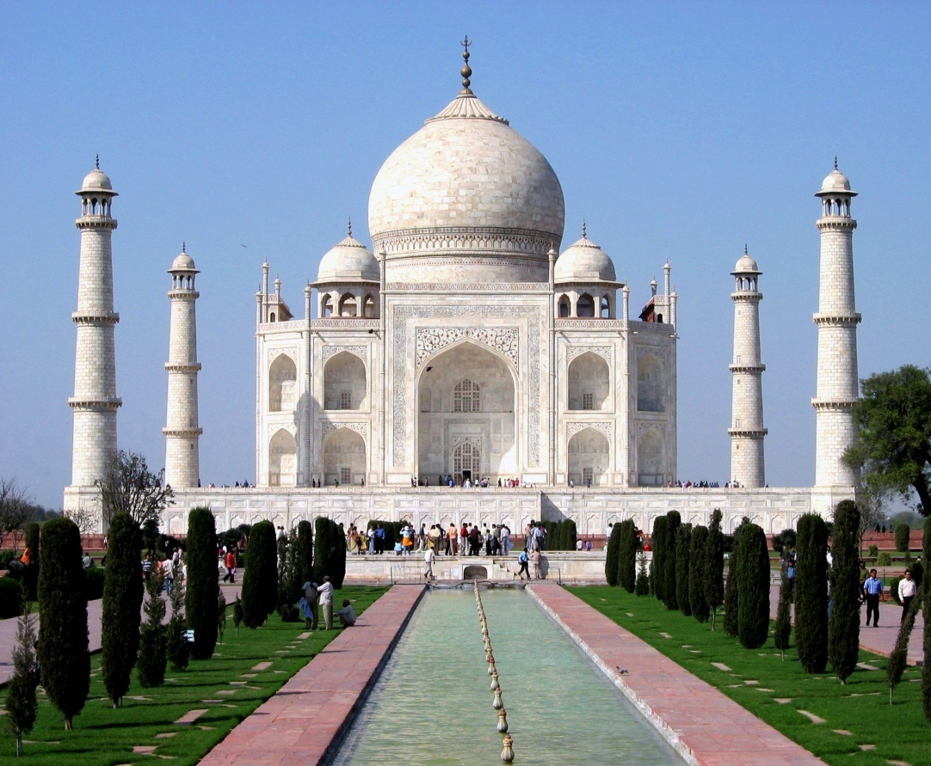
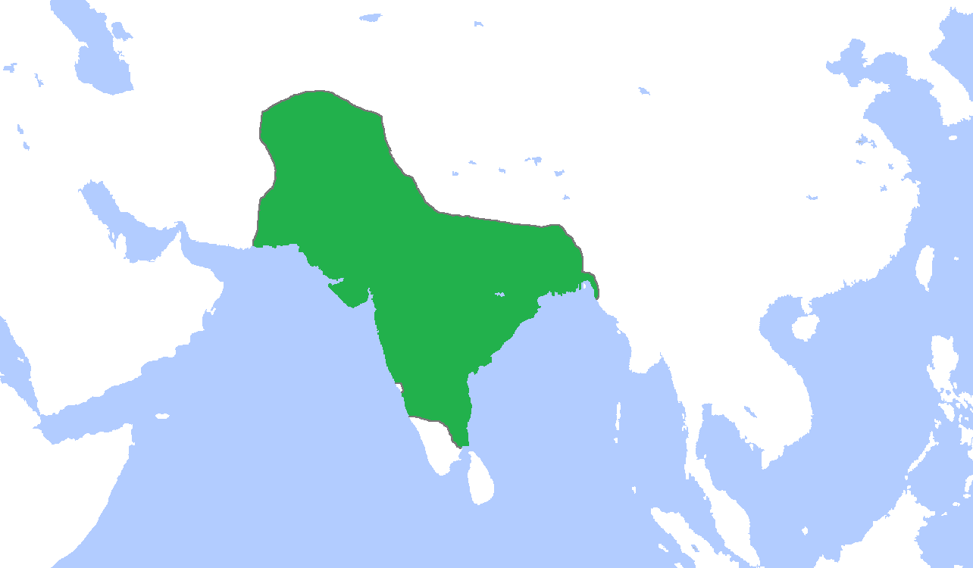
III. Mughal Empire (1526-1750)
A. Islamic conquerors (using gunpowder) took India
B. Achievements
1. Significant population growth with heavy agriculture
2. Taj Mahal- built by Shah Jahan as tomb in memory of his wife

Slide 5
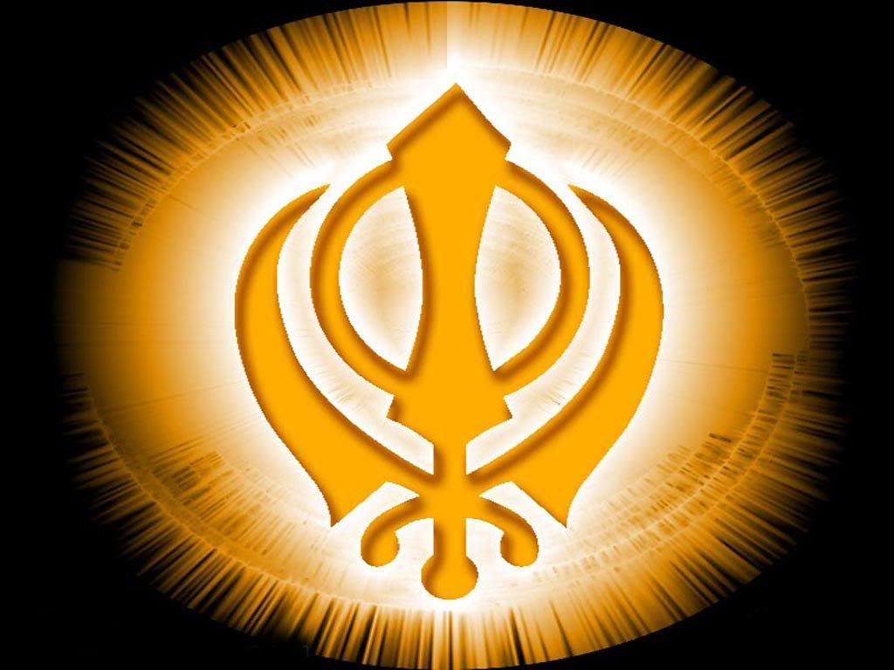
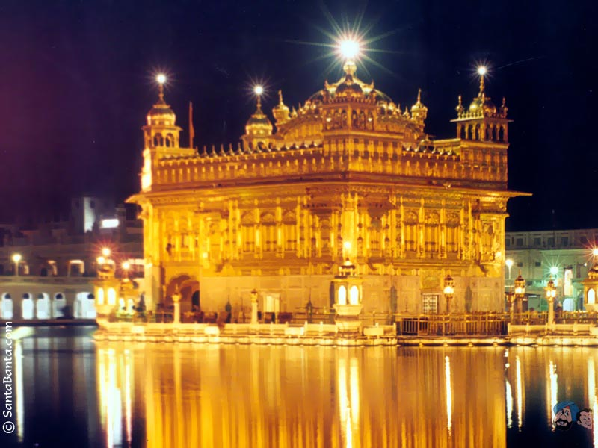
C. Religion
1. Muslims ran the government but allowed religious tolerance
2. Sikhism- religion that blended elements of both Islam and Hinduism

Slide 6
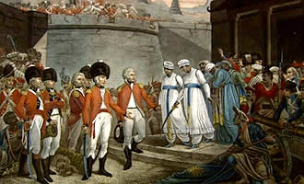
D. Decline
Later rulers persecuted Hindus and Sikhs leading to rebellion
European merchants (especially the British) gained more influence in India through local leaders

