Slide 1
“Islamic Gunpowder Empires: Ottoman Empire”

Slide 2
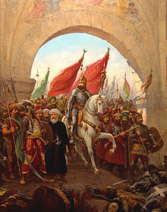
I. Ottoman Empire (1300-1918)
A. Sunni Muslim Turks from central Asia migrated into Asia minor (modern day Turkey)
B. Mehmet II, using cannons, took the Constantinople in 1453, renamed Istanbul

Slide 3
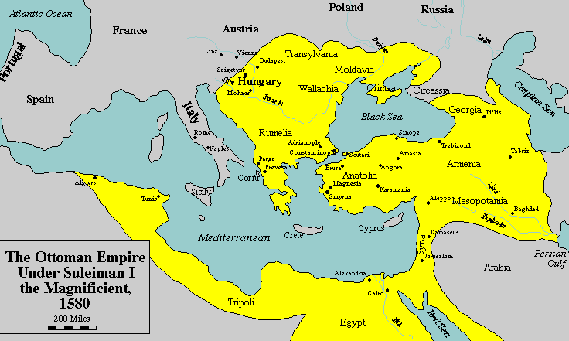
C. Expansion: eastern Europe, Middle East, North Africa
1. Gunpowder technology, strategy, and organization made it most powerful empire of the time
2. Controlled trade along Mediterranean Sea

Slide 4
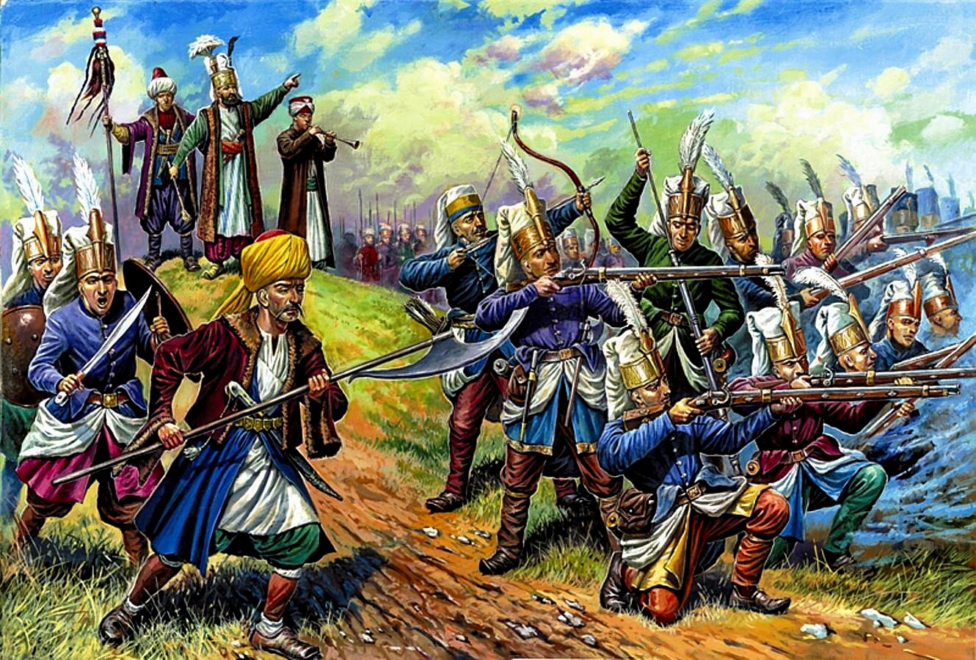
3. Religious freedom for Christians and Jews
4. Janissaries- enslaved Christian boys taken to be enslaved and made elite soldiers loyal to the sultan

Slide 5
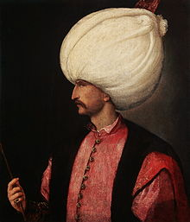
D. Suleiman the Magnificent
Military expanded all the way to Vienna, Austria
Reformed taxes and bureaucracy
Improved the court system and legal code; reduced corruption with new laws

Slide 6
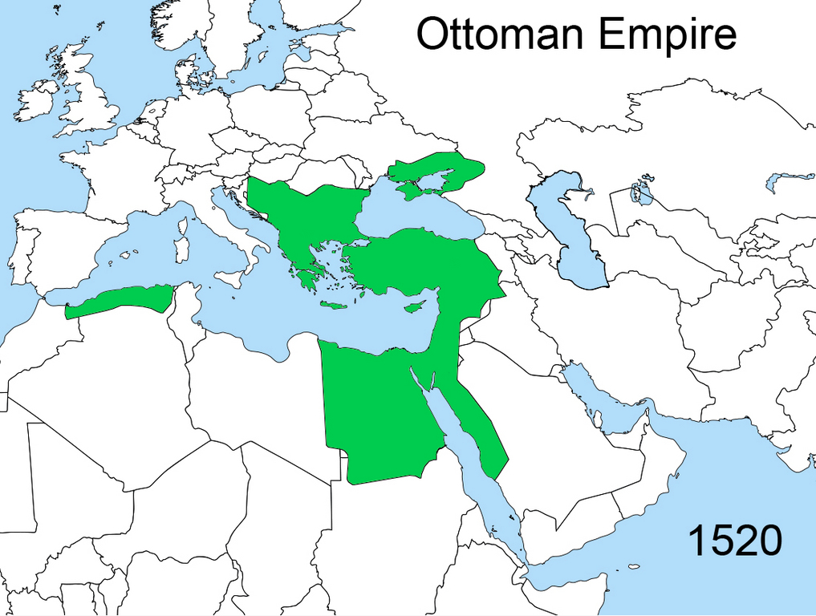
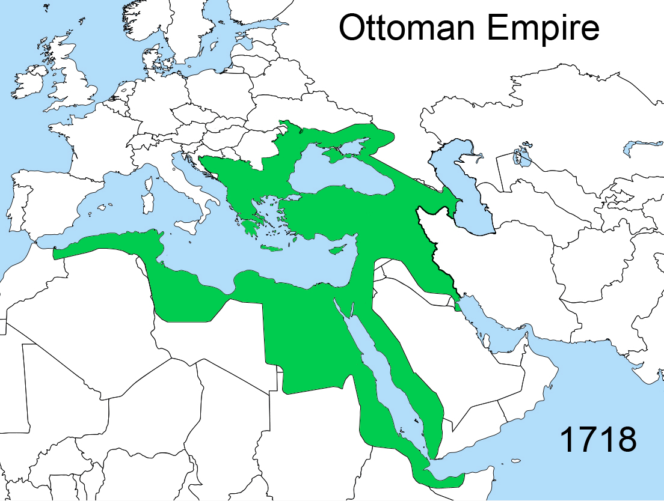

Slide 7
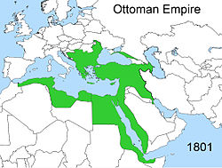
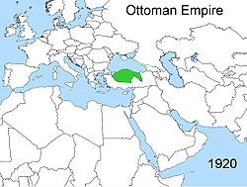
E. Decline:
too large to manage- widespread corruption
Slow to adapt to Western manufacturing and technology (banned the printing press)
Slowly lost territory but lasted until WWI

