Slide 1
Late Chinese Dynasties: Ming and qing

Slide 2
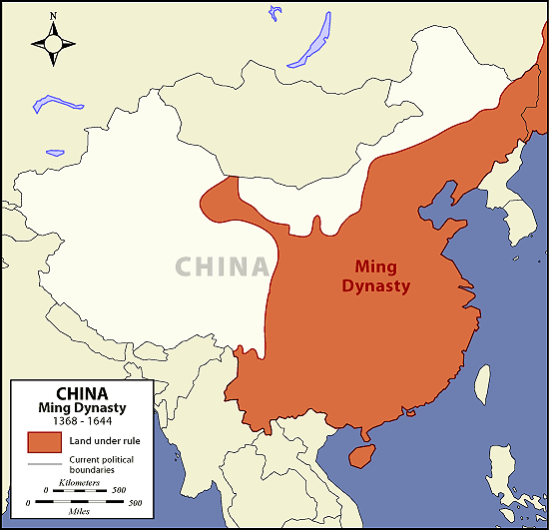
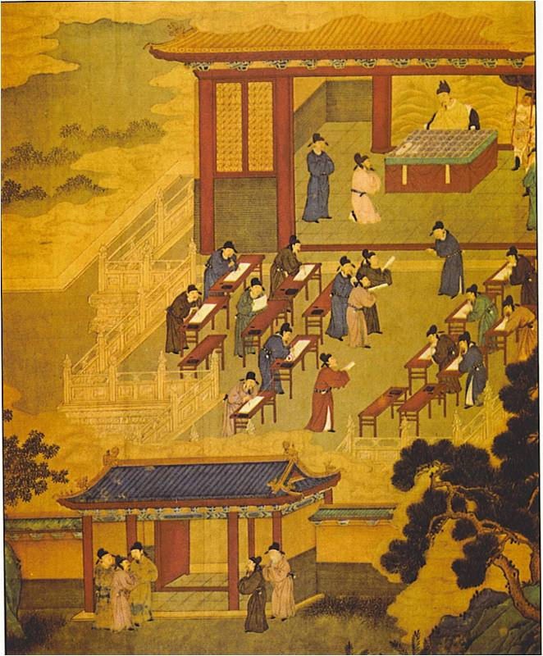
IV. Ming Dynasty (1368-1644)
A. Peasants defeated the last of the Mongol armies and claimed the mandate of heaven
B. Restored culture based on Confucianism and civil service

Slide 3
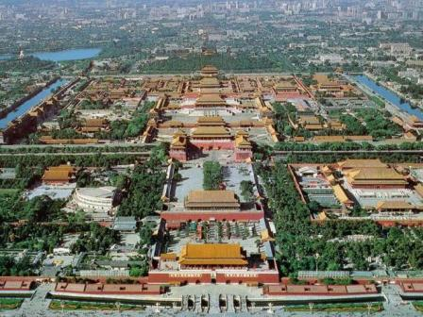
C. Ruled from Forbidden City complex in Beijing, Emperor became isolated from his people – WHY?!?!

Slide 4
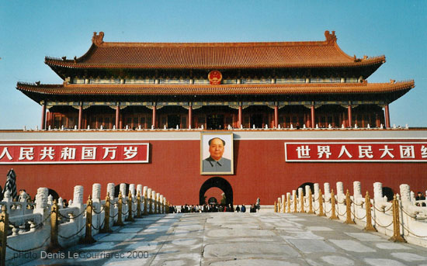

Slide 5
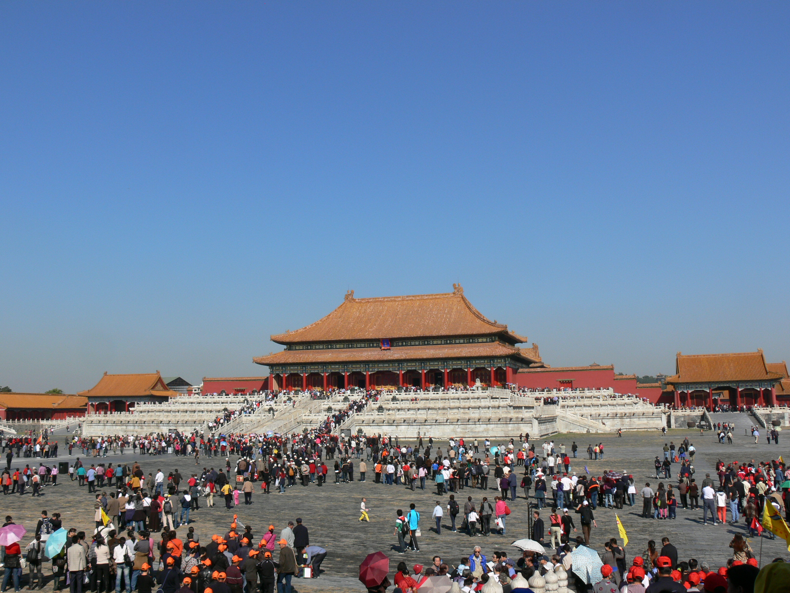

Slide 6
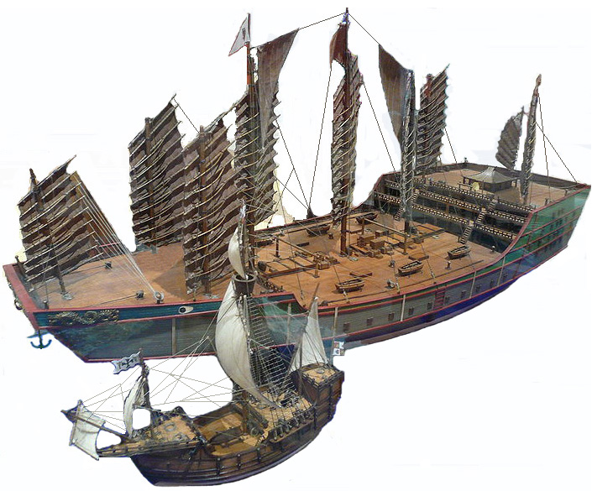
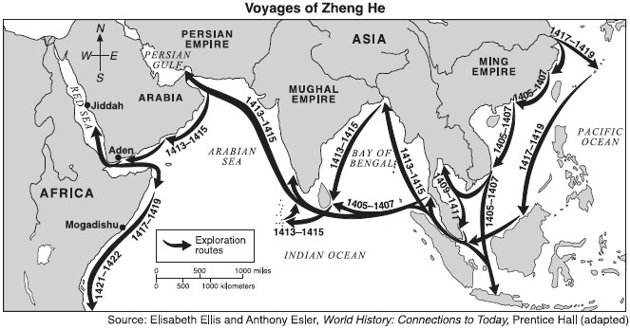
D. Foreign Relations
1. Admiral Zheng He extended Ming influence by leading a huge fleet to collect tribute from around the Indian Ocean
2. After, China became isolated but had limited trade with Europeans

Slide 7
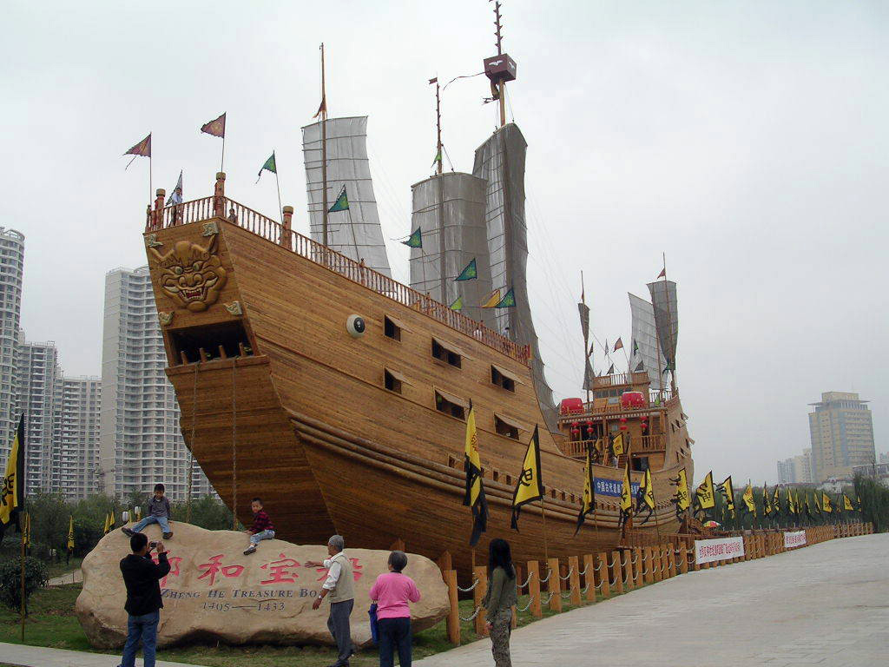

Slide 8
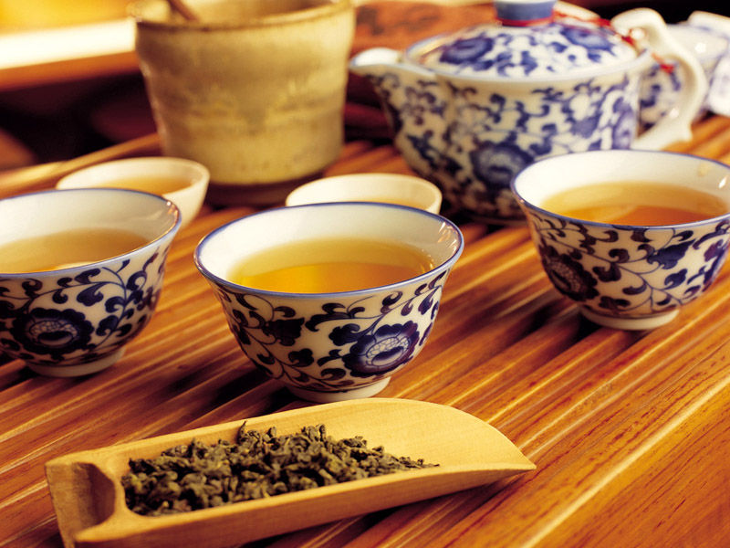
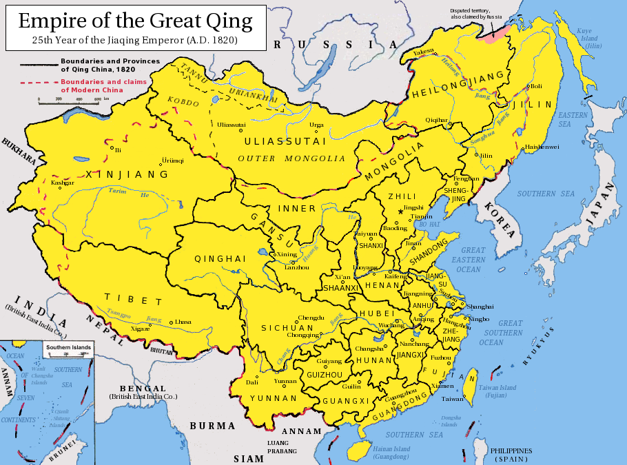
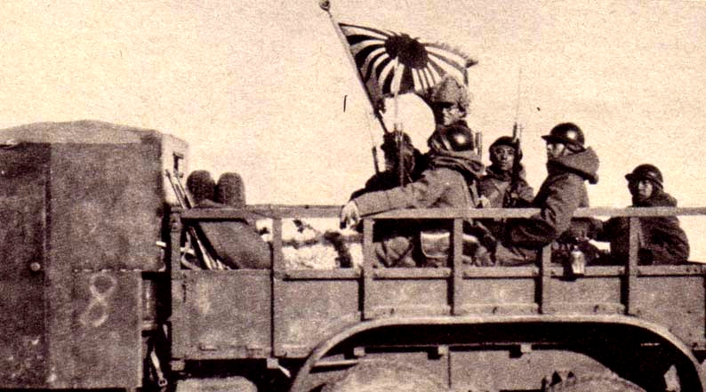
V. Qing Dynasty (1644-1911)
A. Manchu (NE China) invaded and started a new dynasty
B. Economy prospered with export of tea

Slide 9
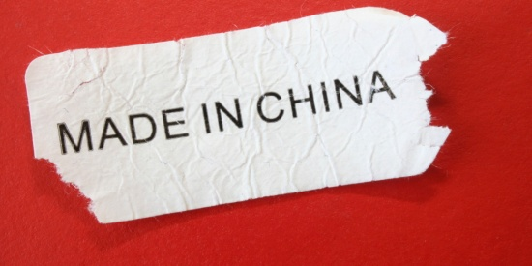
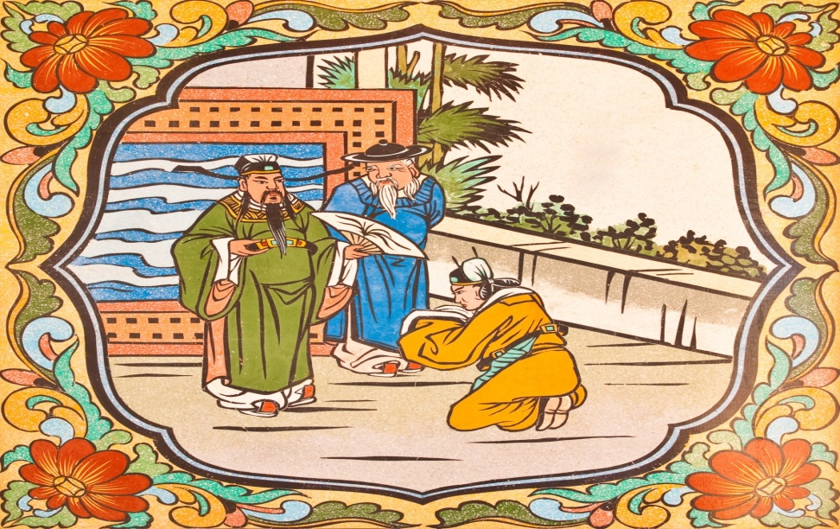
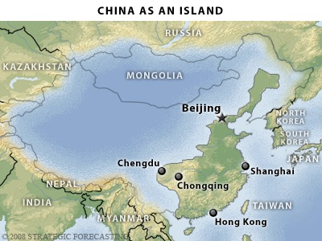
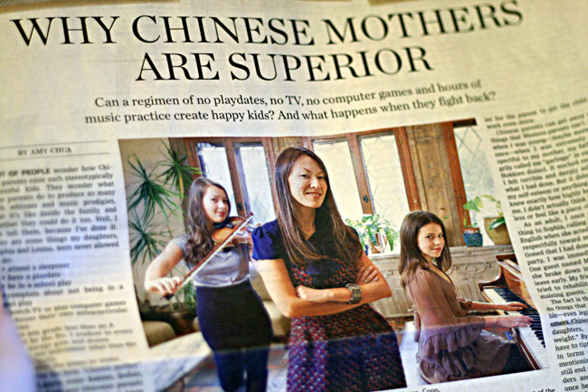
C. Chinese believed that their goods and culture were superior to Europeans
D. Isolation prevented them from keeping up with European advancements

