Slide 1
Late Chinese Dynasties: Tang, Song, & Monogls

Slide 2
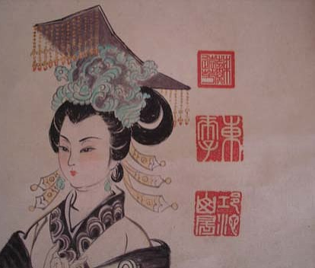
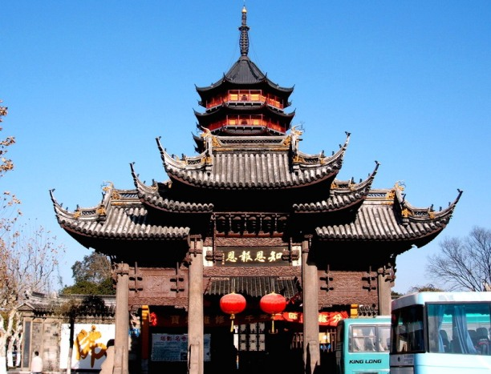
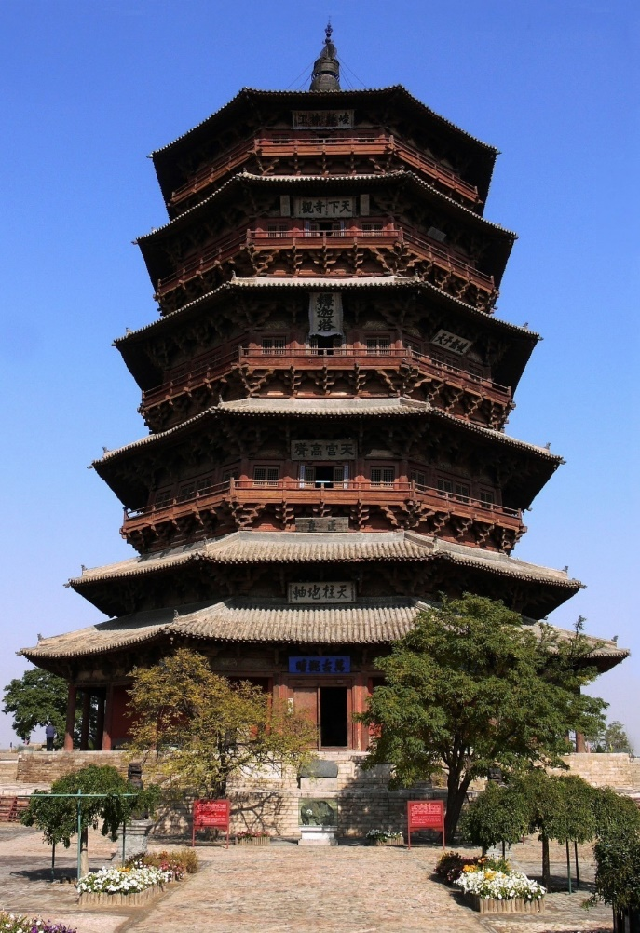
I. The Chinese Golden Age (Tang 618-907 Song 960-1279)
A. Tang restored a strong central government with bureaucracy after a period of disunity
B. Buddhism became the main religion
Wu Zetian

Slide 3
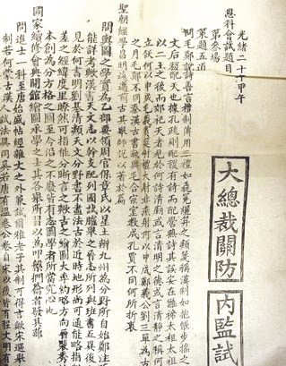
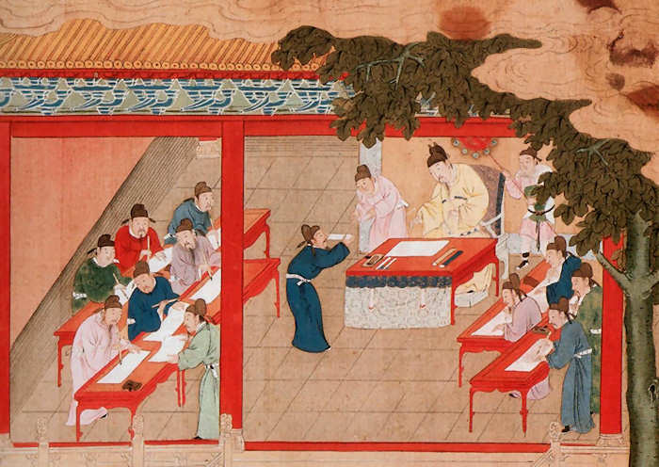
C. Expanded the civil service system to allow any person to try to take the exams- great honor and status to pass

Slide 4
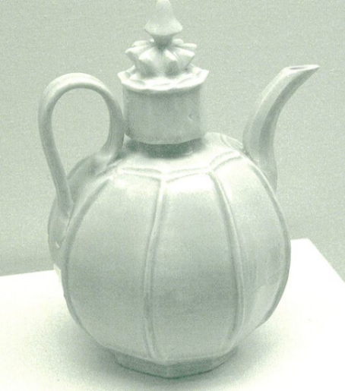
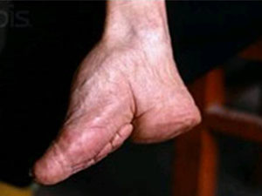
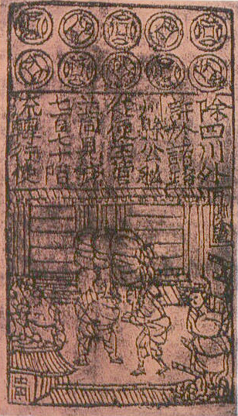
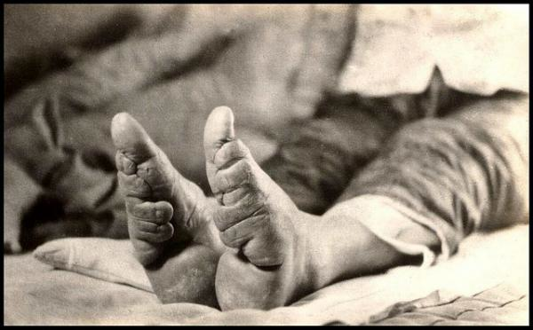
D. Inventions: printing press, gunpowder, paper money, compass, porcelain
E. Practiced foot binding- limited women’s movement

Slide 5
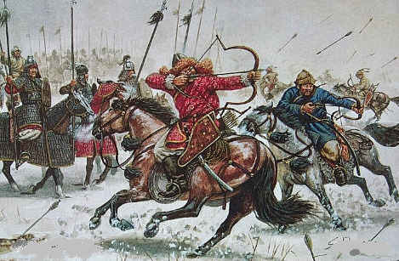
F. Overthrown by the Mongols

Slide 6
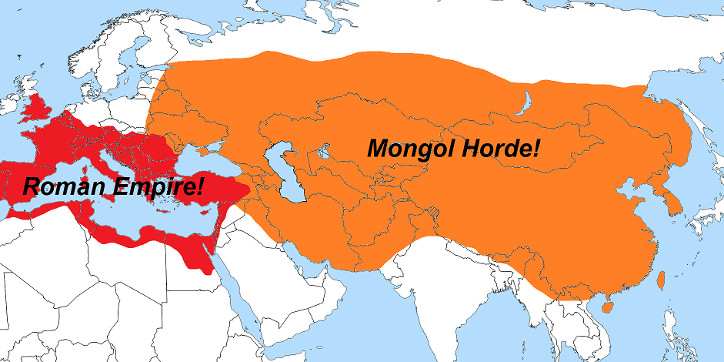
II. The Mongolian Empire
A. The Mongols were a nomadic pastoralist people from central Asia with a history of invading China

Slide 7
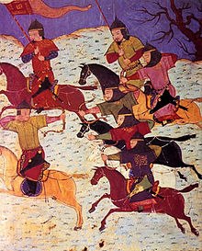
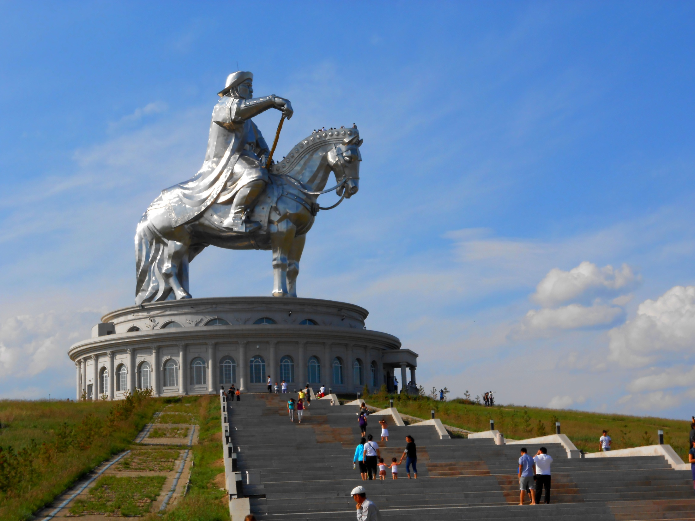
B. Tribes united by Genghis Khan (universal ruler)- 1206 AD
great military leader who used his cavalry to defeat all enemies

Slide 8
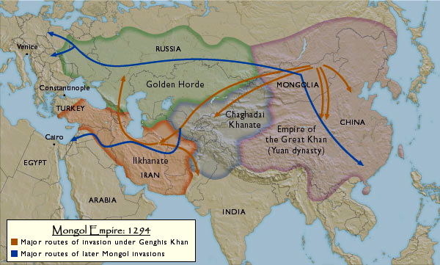
2. Enemy cities were either destroyed or became tributary states- self rule, but must give resources
3. After Genghis Khan died, empire split in four empires- Pax Mongolia (era of Mongol peace)

Slide 9
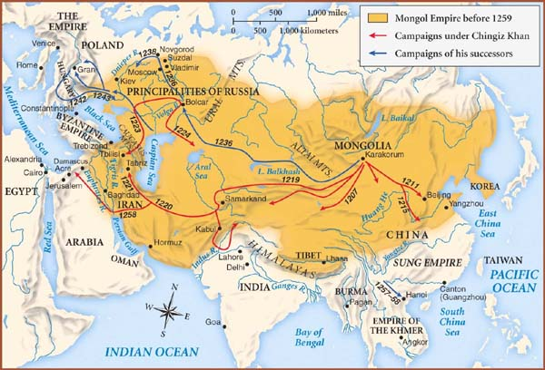

Slide 10
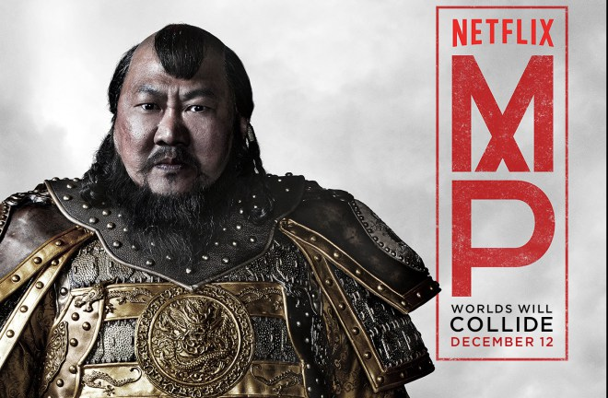
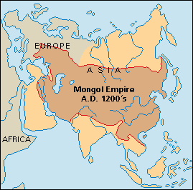
C. The Yuan Dynasty (1279-1368): Mongol Rule
1. Kublai Khan (Genghis Khan’s grandson) conquered China and declared himself emperor

Slide 11
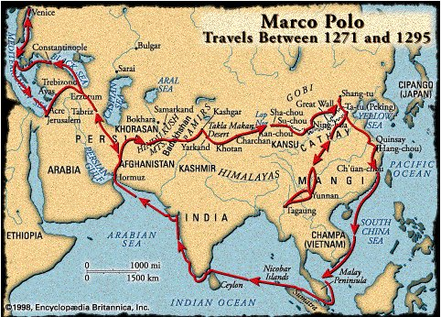
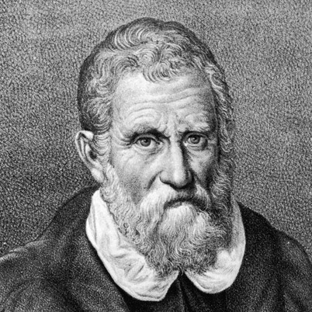
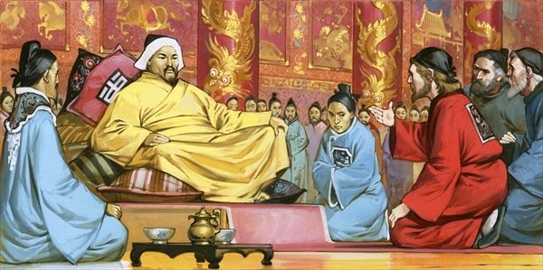
2. Visited by the European explorer Marco Polo
3. Tried to invade Japan but defeated by typhoons

