Slide 1
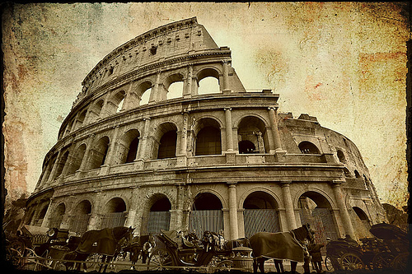
Ancient Rome

Slide 2
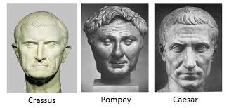
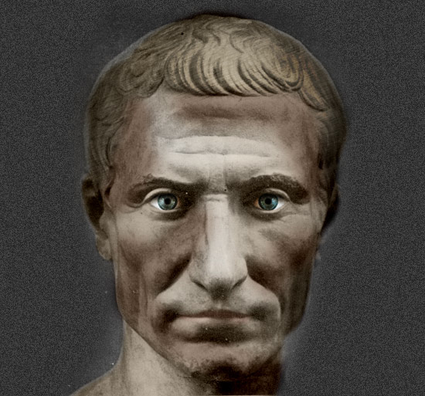
II. The Roman Empire
The Roman Republic had a law that allowed for a dictator to be appointed in a time of crisis
Growing empire tension on gov’t civil war dictator
B. Julius Caesar defeated his rivals (Crassus and Pompey) and was declared “consul” for life in 44 B.C.

Slide 3
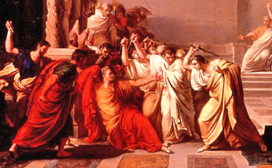
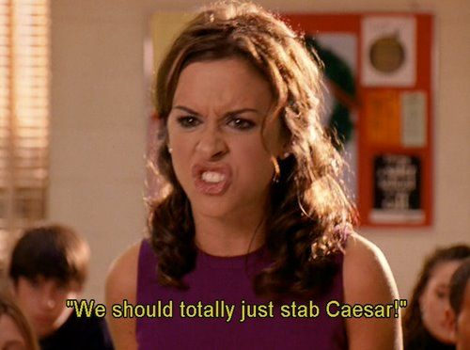
C. Members of the senate believed Julius Caesar wanted to destroy republic
D. Senate assassinated him
1.Rome was divided between Octavian and Marc Antony (allied with Cleopatra)

Slide 4
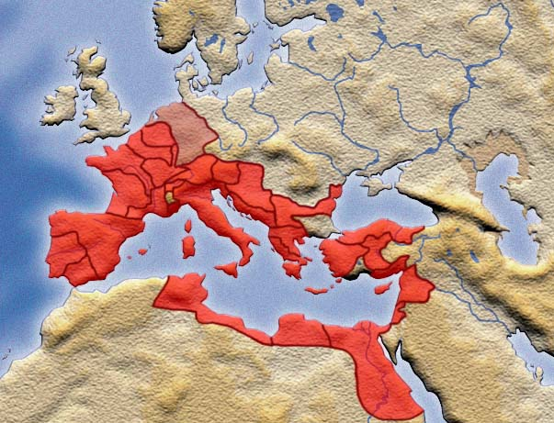
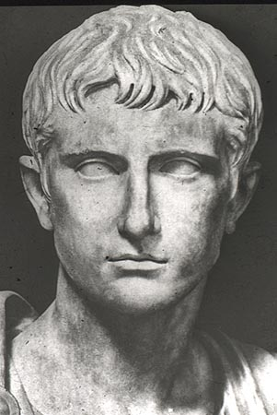
E. Octavian won and changed named to Augustus- Rome’s first emperor, controlled most of Europe.
F. Began the era of Pax Romana (Roman peace)
When Augustus takes over Rome we officially consider it to be the end of the “republic” and beginning of the “empire.”

Slide 5
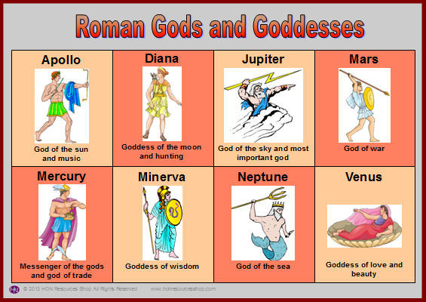
III. Contributions and Life of the Romans
A. Religion- Polytheistic, based on Greek gods
B. Entertainment- subsidized by government

Slide 6
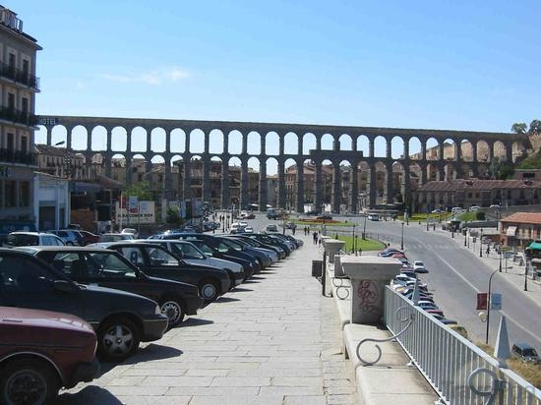
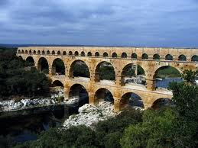
C. Law- foundation for all of future Europe
E. Latin- Roman language
D. Engineering- stonework and concrete made superior roads, bridges, arches, and aqueducts (bring water from 50 miles away)

Slide 7
Life in the Roman Empire…
You don’t have to take notes here. Just look through the various forms of entertainment, often provided by the government. Watch the intermittent videos. At the end, you will be asked to evaluate life during the Roman Empire.

Slide 8
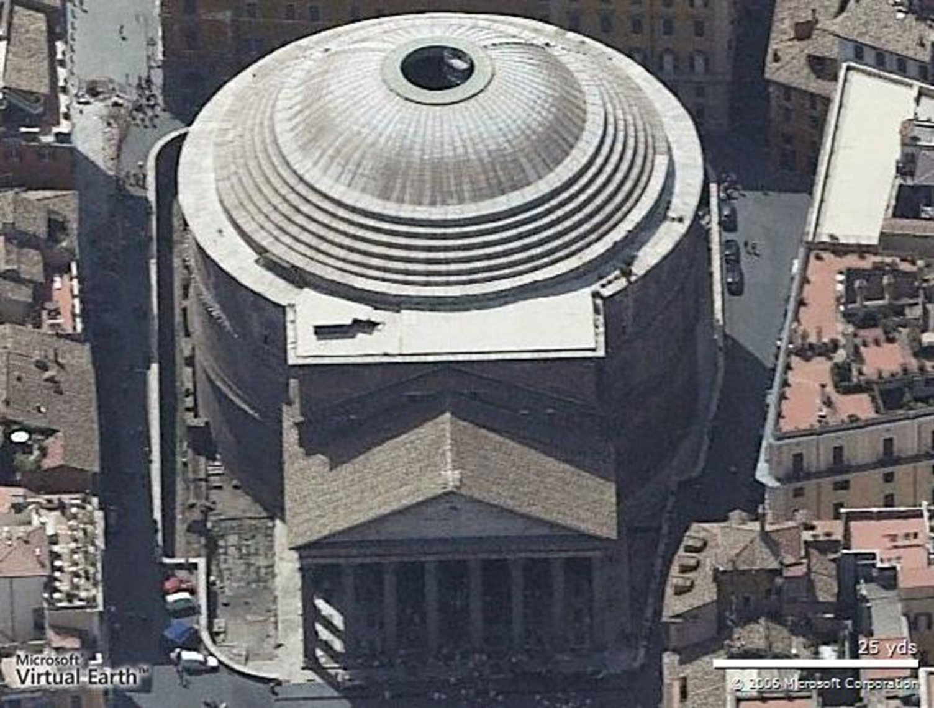
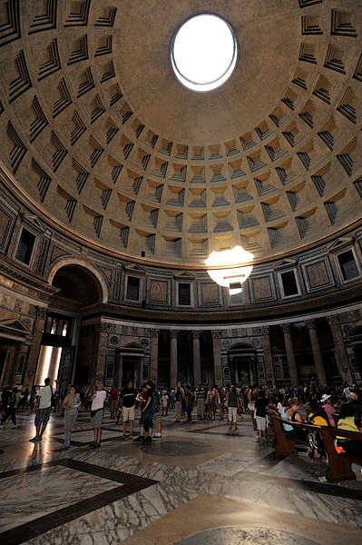
The Pantheon (to worship all the gods)
Largest unsupported concrete dome

Slide 9
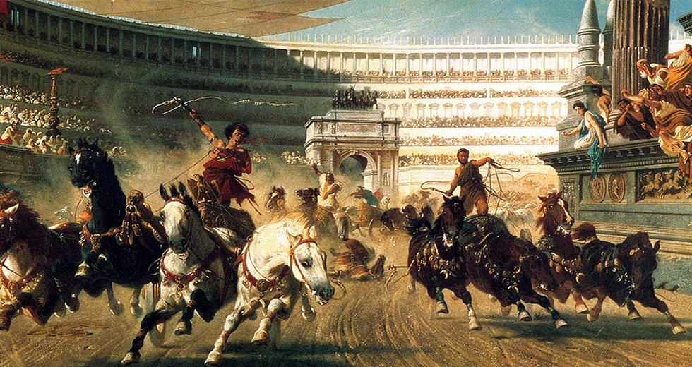
Circus Maximus
About .37 miles long
About 400 feet wide
Seated 250,000-300,000

Slide 10
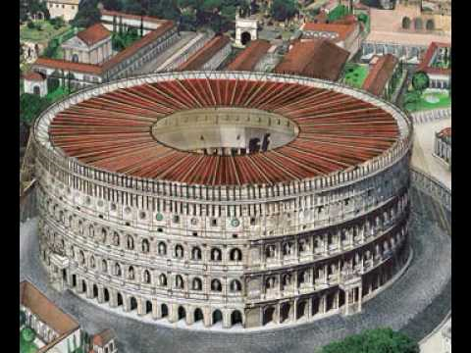
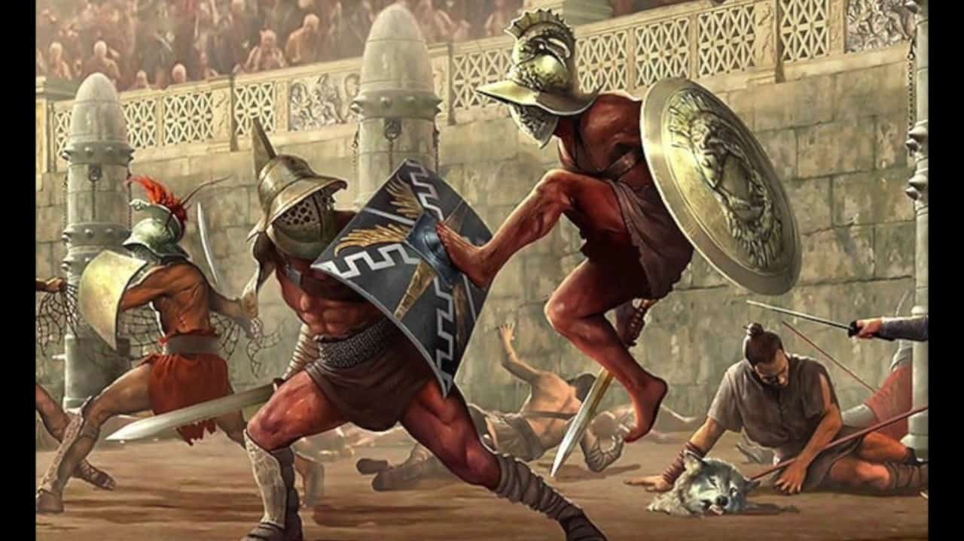
The Colosseum
Sat around 50,000
Gladiator Battles
Sea battles

Slide 11
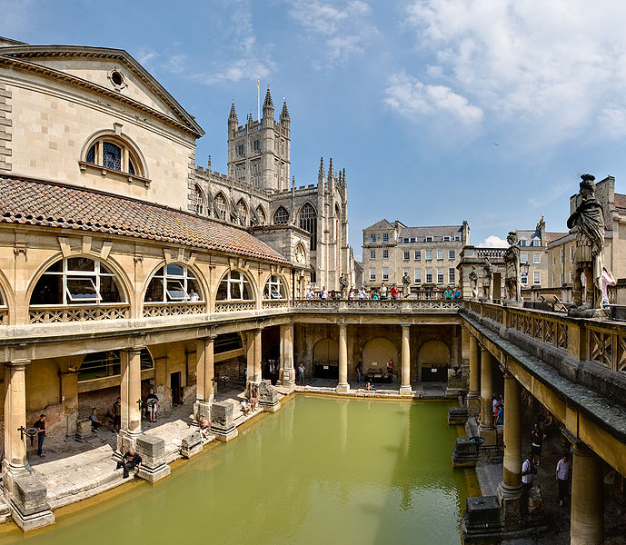
Roman Baths
Communal baths
Up to 3,000 people
Heated (like modern day spa)
Affordable and sometimes free

