Slide 1
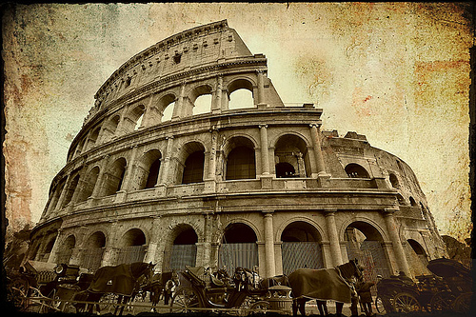
Ancient Rome

Slide 2
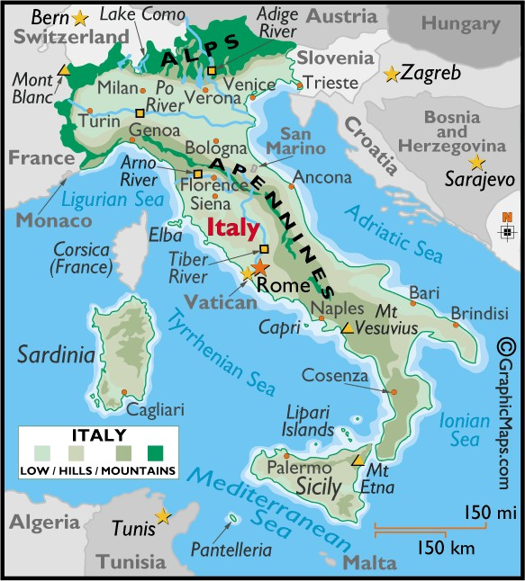
I. Early Roman Republic
Geography
Located on a peninsula surrounded by Mediterranean Sea
Protected by Alps to the North

Slide 3
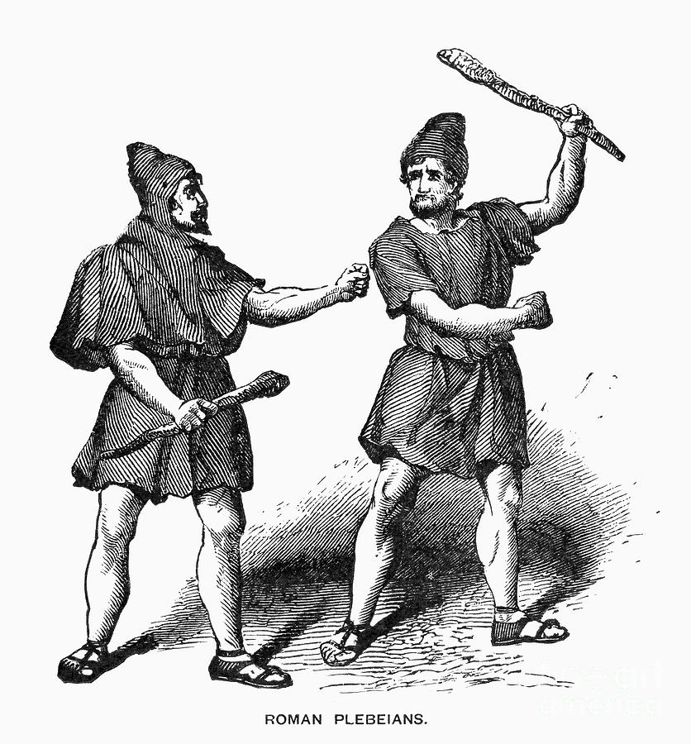
B. Classes
Patricians- elite landowning families that controlled most of society
Plebeians- common people

Slide 4
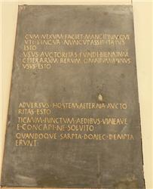
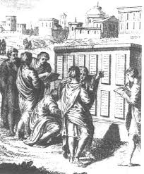
3. Law of the Twelve Tables- Constitution of the Republic, enforced the equality under the law for all

Slide 5
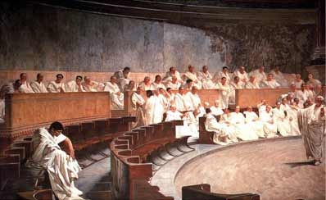
C. Republic-government of elected officials
1. Senate: group of patricians controlled finances and wrote laws
2. Tribunes: could veto (ban a law) and tried court cases, chosen by plebeians
3. Two consuls: elected for one year, who led military and chief executives

Slide 7
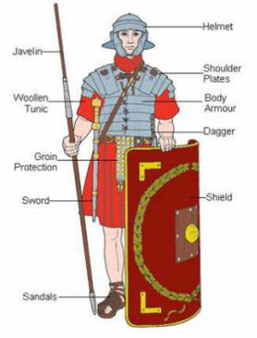
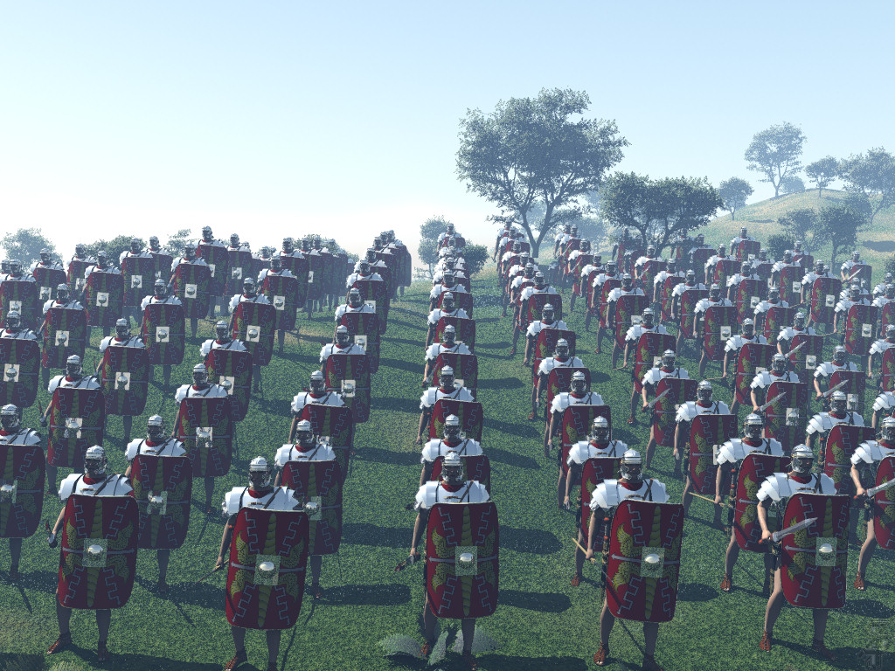
D. Roman Legions
(military unit) conquered Italy and defeated enemies

