Slide 1
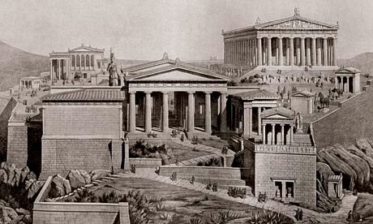
The Greeks

Slide 2
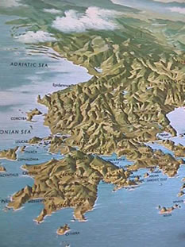
I. Geography
Located around the Aegean Sea
Mountainous islands
Poor for farming
Geographical isolationism leads to vastly different culture, gov’t, etc.

Slide 3
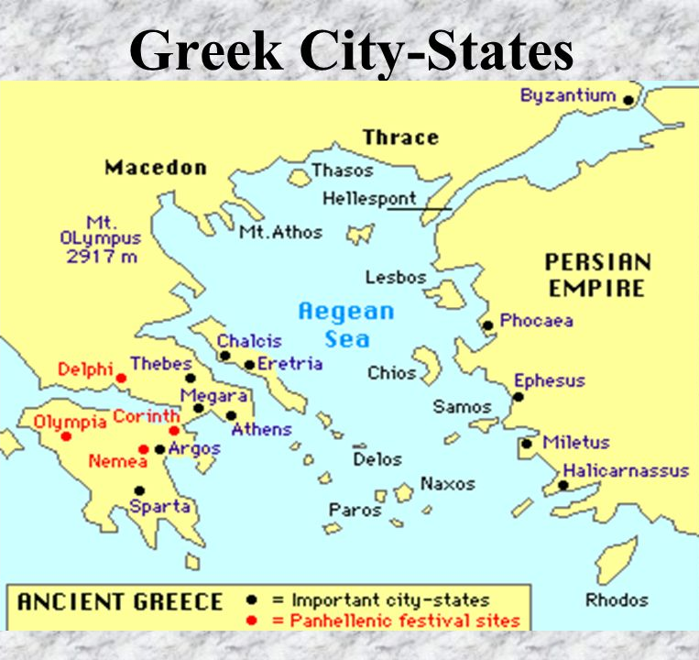
II. The City-States
A. The Polis
1. polis- Greek city state
2. Governments:
- democracy (people rule)
- monarchy (king/queen)
- oligarchy (group of people rule)

Slide 4
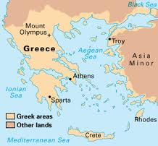
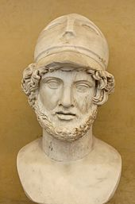
B. Athens
1. first ruled by a tyrant- strong oppressive ruler
2. became a direct democracy- all people vote ( men, military, over 20)
3. center of learning
and philosophy
4. Good treatment of
non-citizens
(tolerant and enlightened)

Slide 5
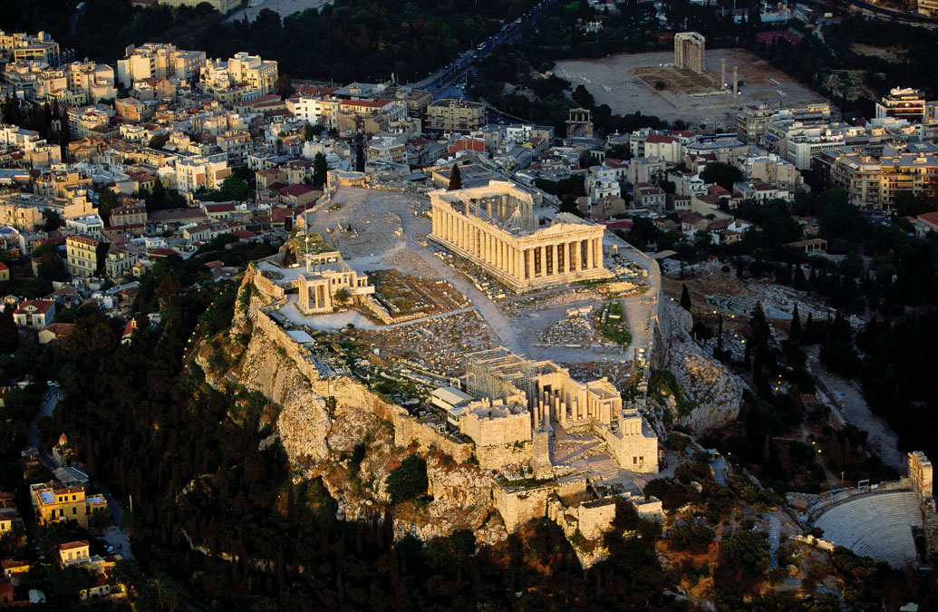

Slide 6
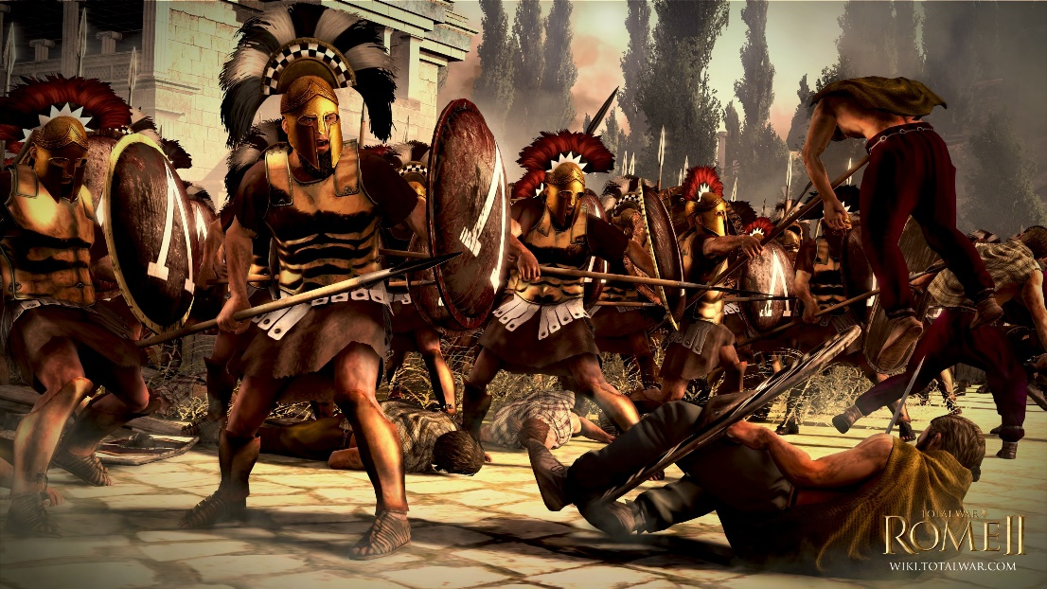
C. SPARTA
Mightiest military of Greek states
Spartans created warrior society (7 slaves to 1 Spartan)
Ruled by two kings and a council of elders (oligarchy)

