Slide 1
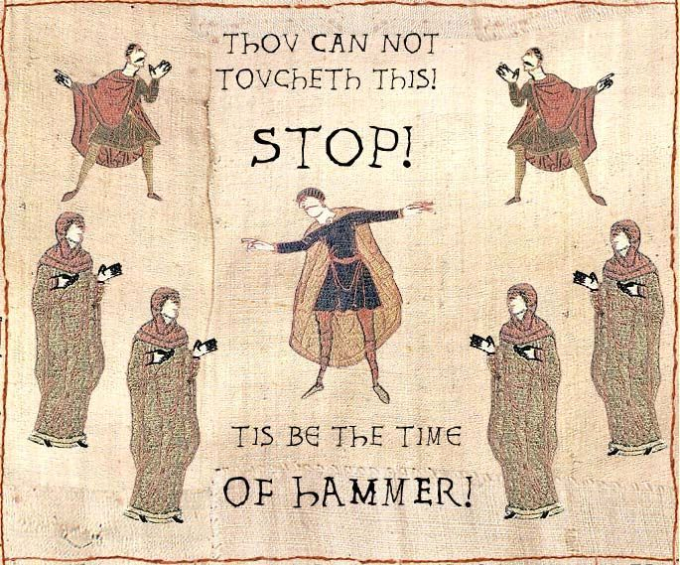
“The Middle Ages”

Slide 2
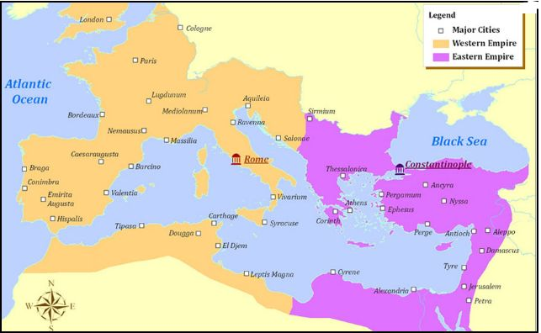
I. Start of Byzantine Empire
Roman Empire divided into East and West
Western part fell, Eastern part became known as “Byzantine Empire”

Slide 3
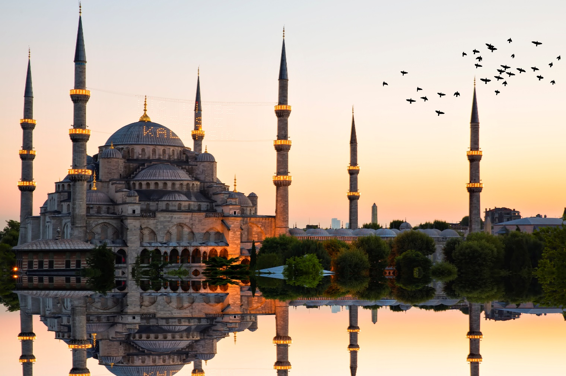
C. Moved capitol to Constantinople.
D. Center for trade and Hellenistic culture

Slide 4
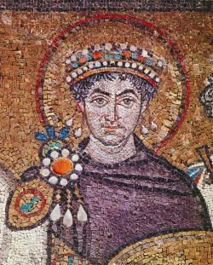
C. Justinian Emperor who retook most of the Western Roman Empire.

Slide 5
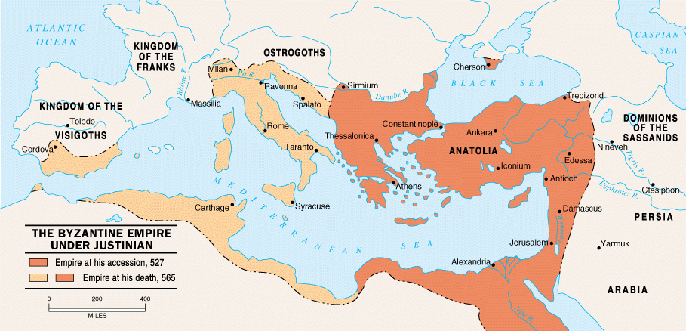

Slide 6
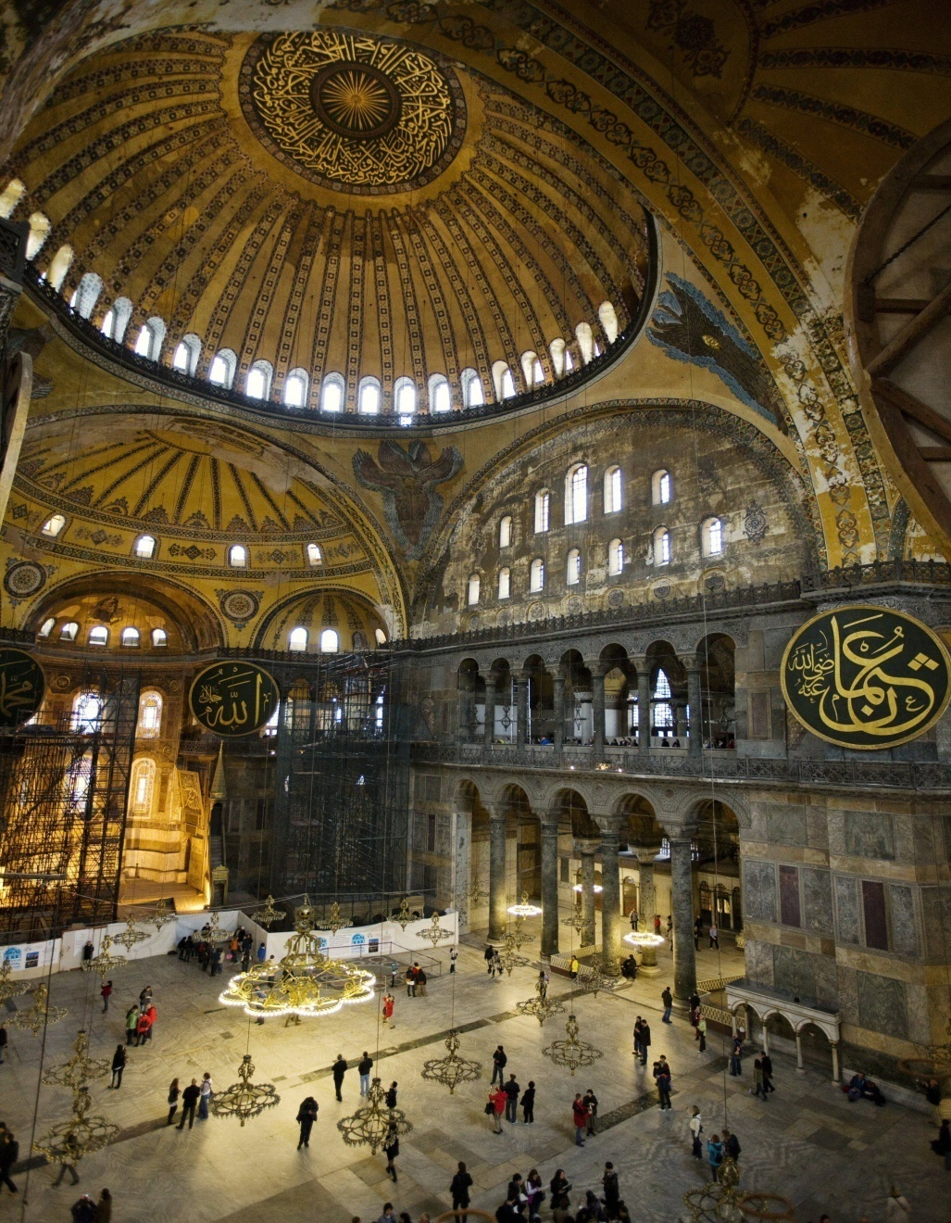
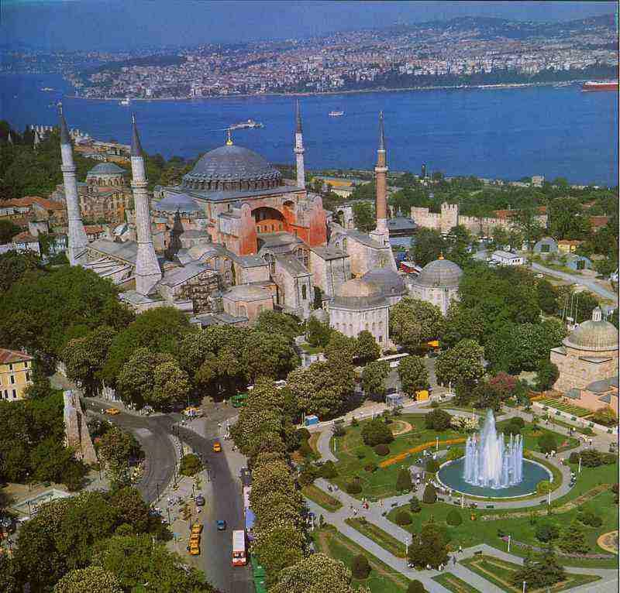
Justinian’s Code- updated Roman Law – foundation for future of Europe
Built Hagia Sophia

Slide 7
D. Great Schism (1054) - Differences in how Christianity was practiced in West vs Eastern part of Empire causes the split
1. Catholic and the Orthodox Church
Orthodox | Catholic
Greek (Byzantine Empire) | Latin (Western Roman Empire)
Clergy Married | Clergy does not marry
Emperor had religious authority | Emperor does not have authority in church
“Orthodox” is Greek for “right belief” | Roman Catholic

Slide 8
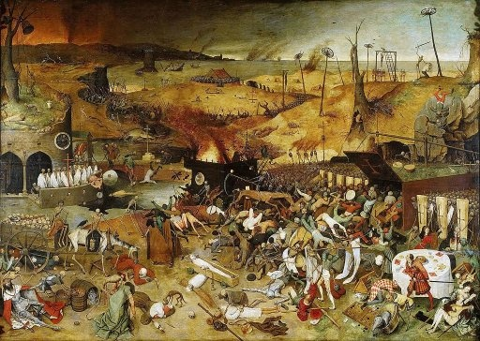
II. Dark Ages in Europe
A. After the fall of the Western Roman Empire, there was chaos with little learning, society, or economy in Europe
B. disunity, people formed small regional kingdoms– the church/Christianity became increasingly important to Europeans

Slide 9
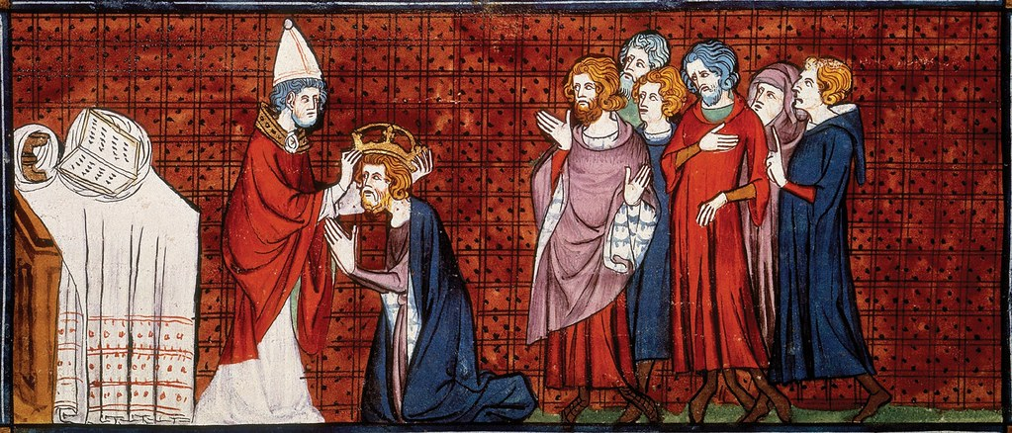
C. Charlemagne (strong military leader)
1. Pope crowned him Holy Roman Emperor after he helped him attack Muslims/Jews in the “holy land”
2. Encouraged learning, made laws, spread Christianity

Slide 10
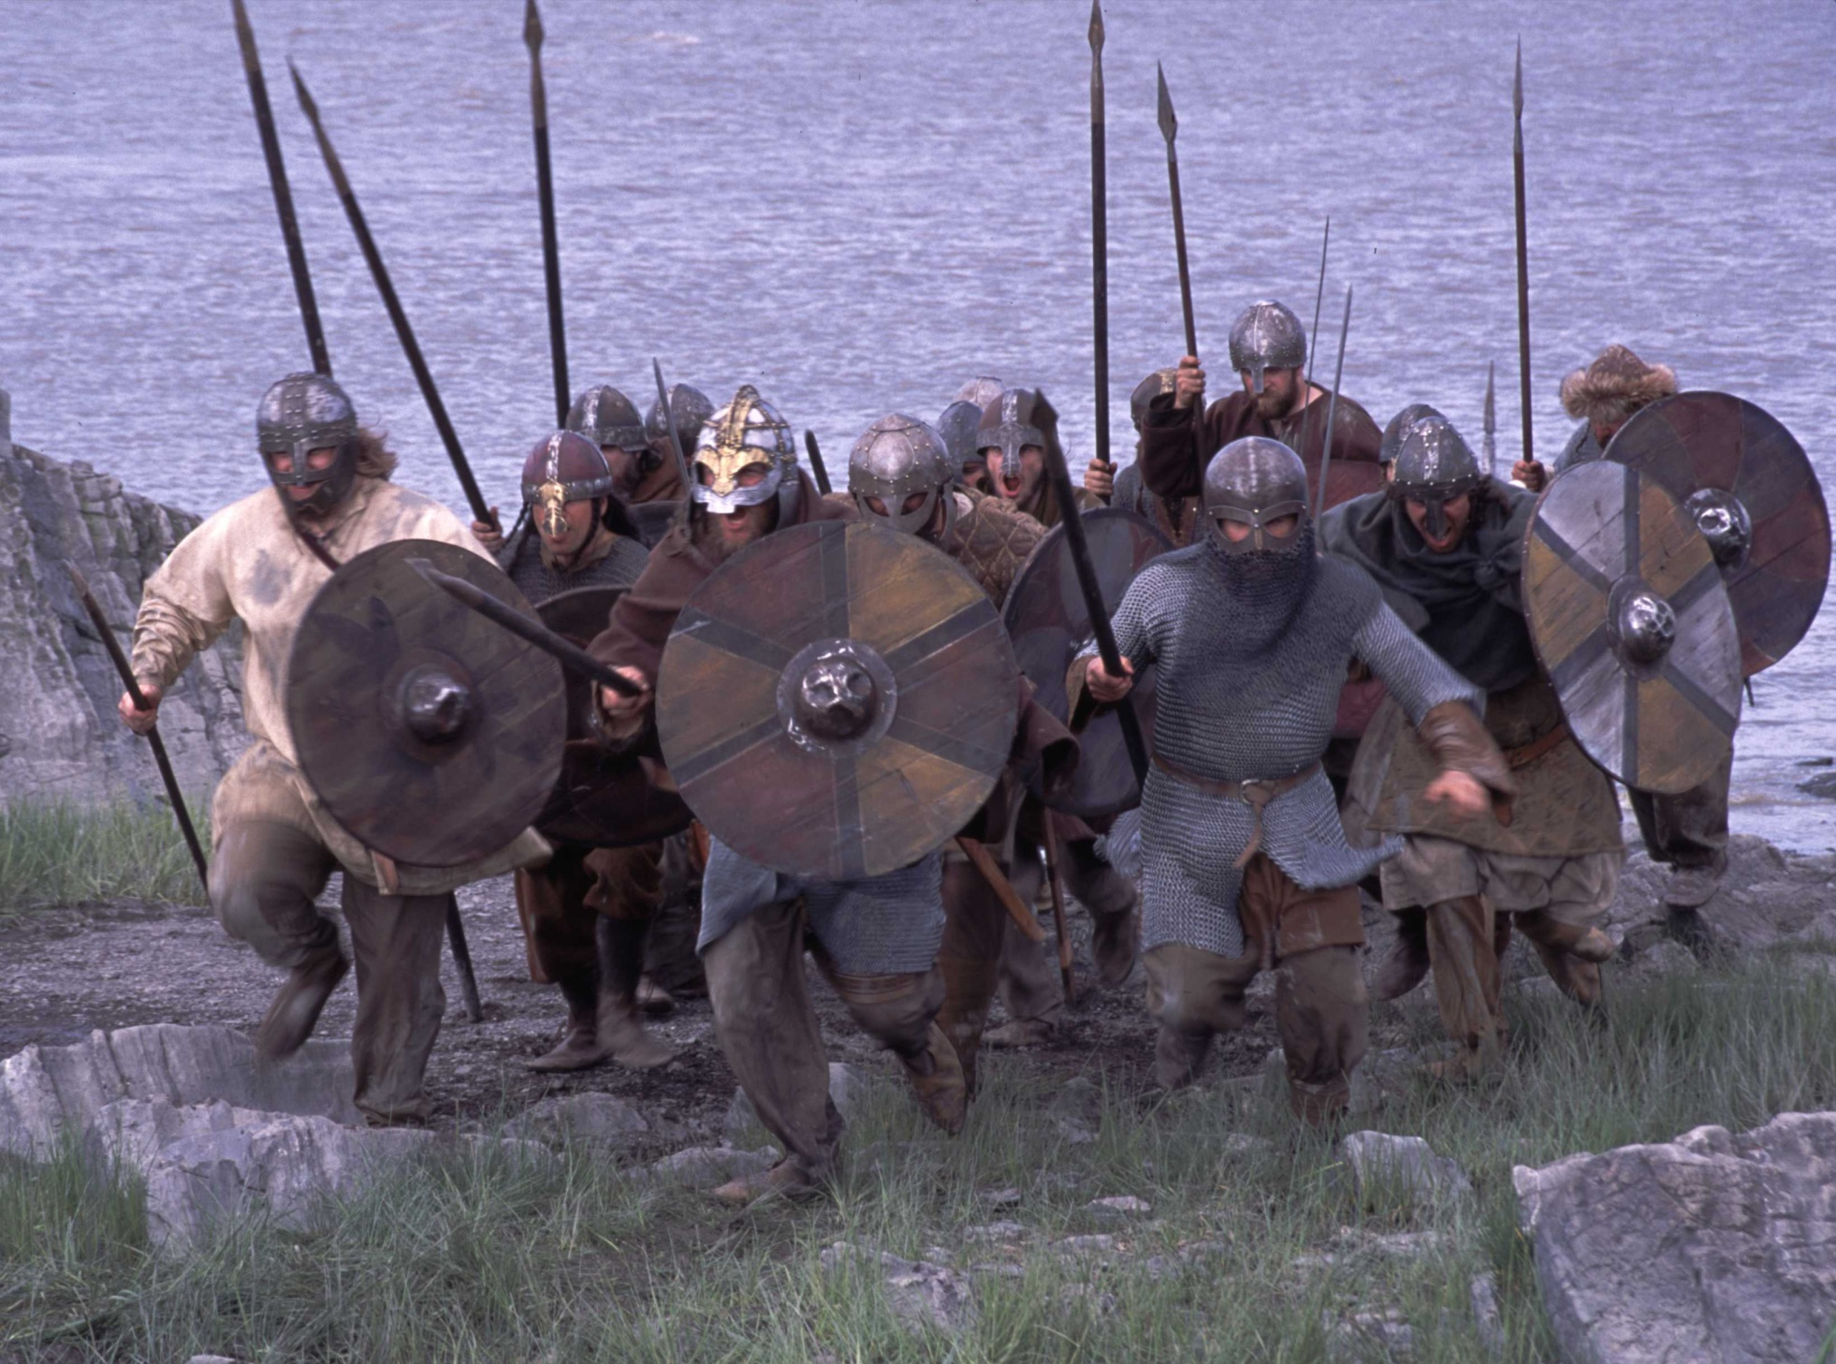
D. Invaders like the Vikings created chaos again
1. Scandinavian fishermen; sacked cities to steal resources; spread fear all over Europe

