Slide 1
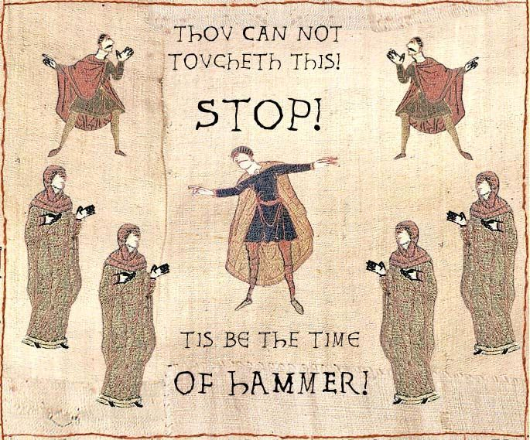
“The Middle Ages”

Slide 2
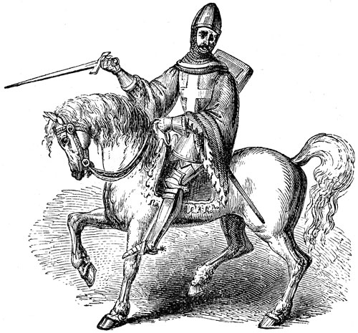
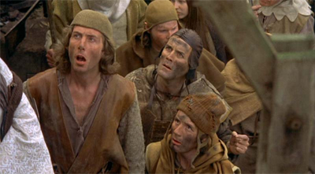
III. Feudal System
A. To protect from invaders, peasants bound themselves to lords and worked in large manors
B. Lords hired knights (mounted warrior class) who got land in return (vassal)

Slide 3
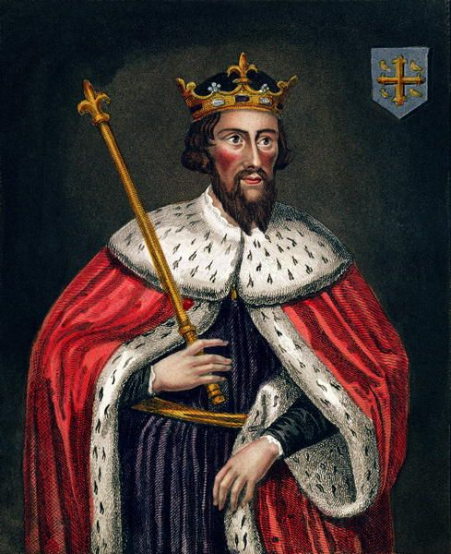
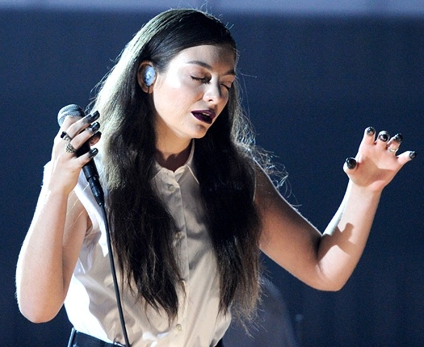
C. Lords competed with each other but were under the king
D. Kings had little power, had a system of give and take with lords

Slide 4
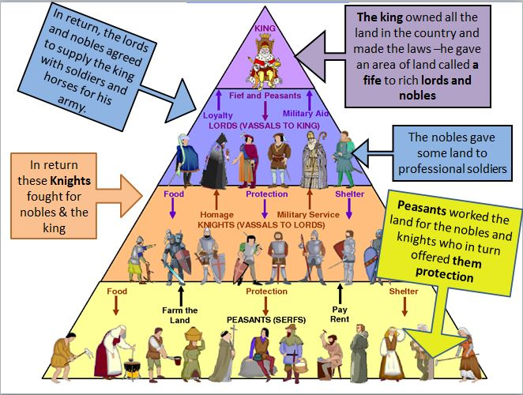

Slide 5
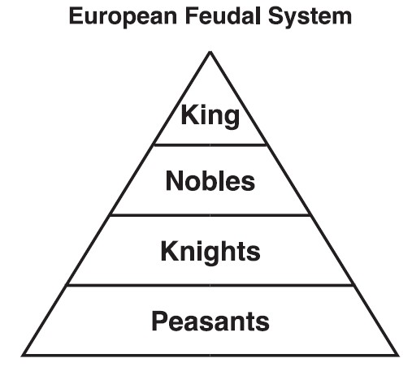

Slide 6
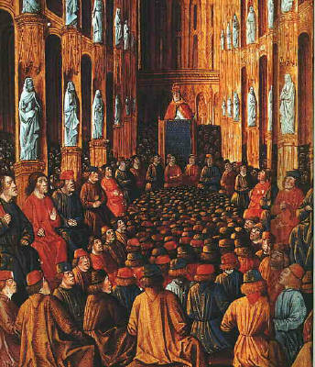
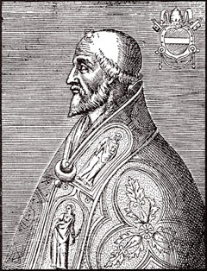
IV. Middle Ages Religion
A. Almost every European was Catholic
B. Pope (the religious & political leader of Catholic Church) oversaw all kings

Slide 7
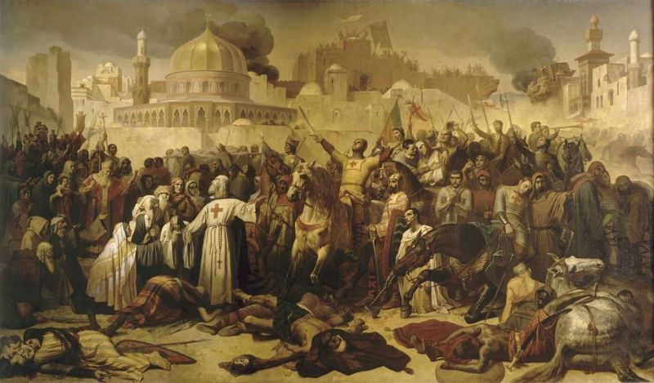
C. Pope Urban II called for Crusades against Muslims in the Holy Land
1. Christians ruled Jerusalem for 100 years before being defeated
2. Christians were exposed to Muslims’ learning, advancements, goods

Slide 8
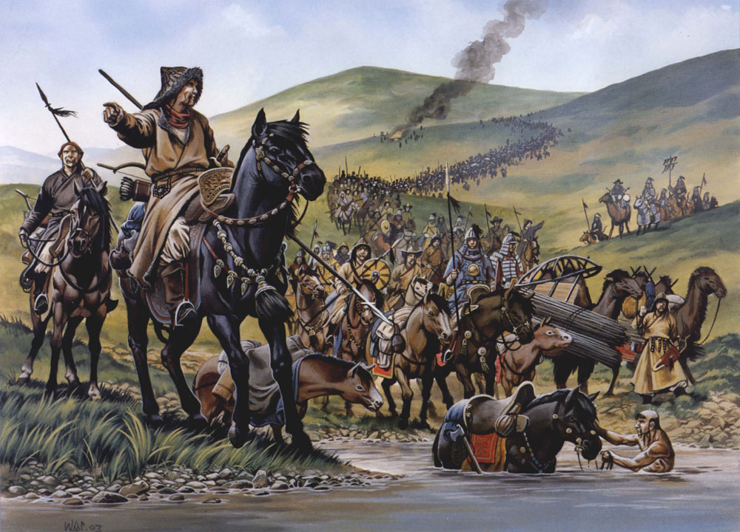
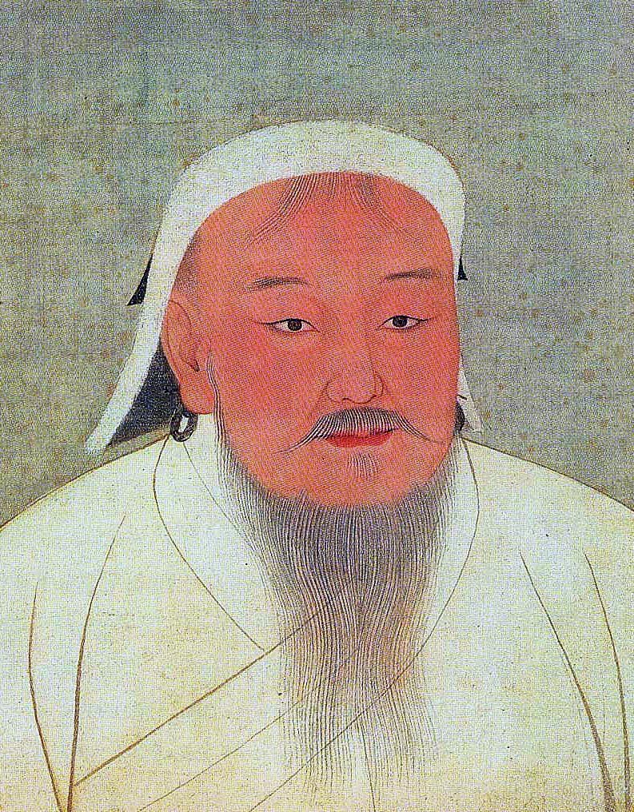
3. Muslim kingdoms were more affected by the rise of the Mongols and the Turks afterward

Slide 9
